Slide 1
Justify!
Acquired Plant Traits
2023 Baylor College of Medicine.

Slide 3
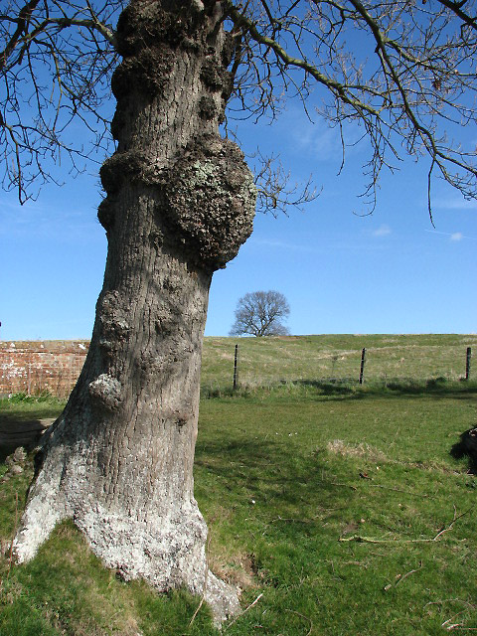

Slide 8
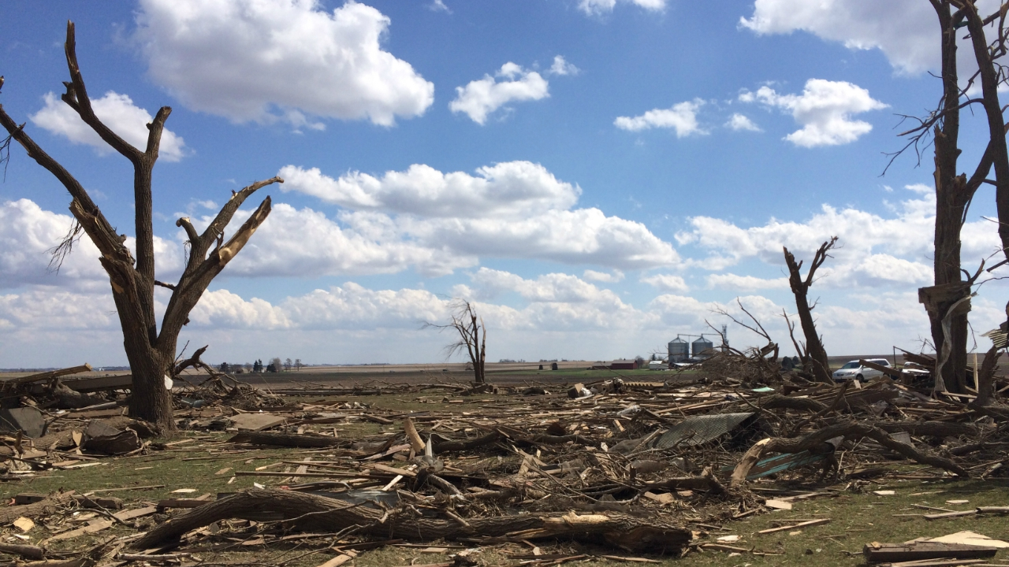

Slide 9
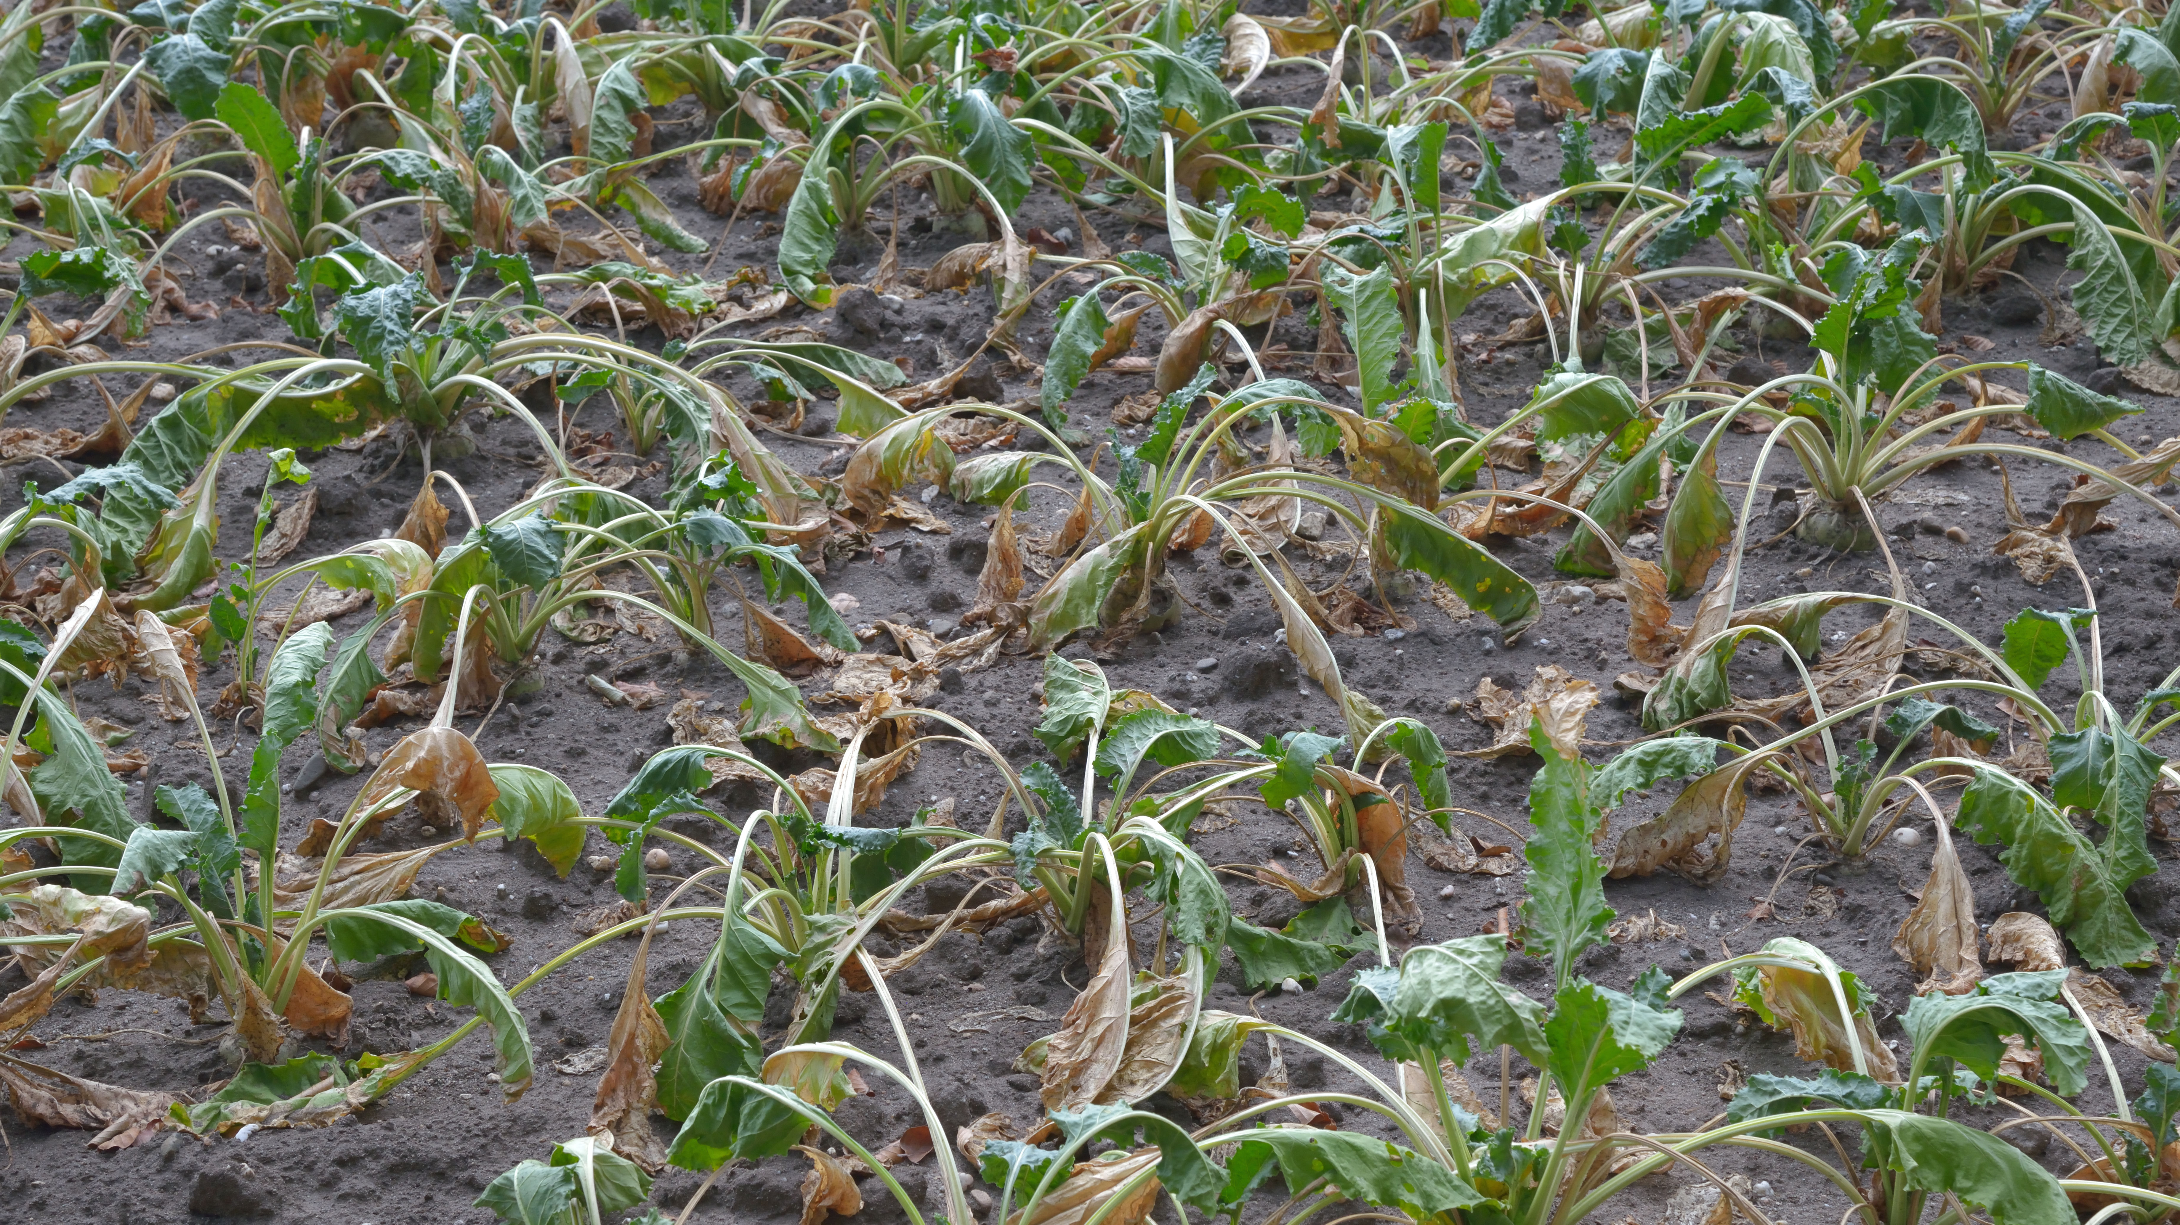

Slide 10
Notes:
This Photo by Unknown Author is licensed under CC BY-ND

