Slide 1
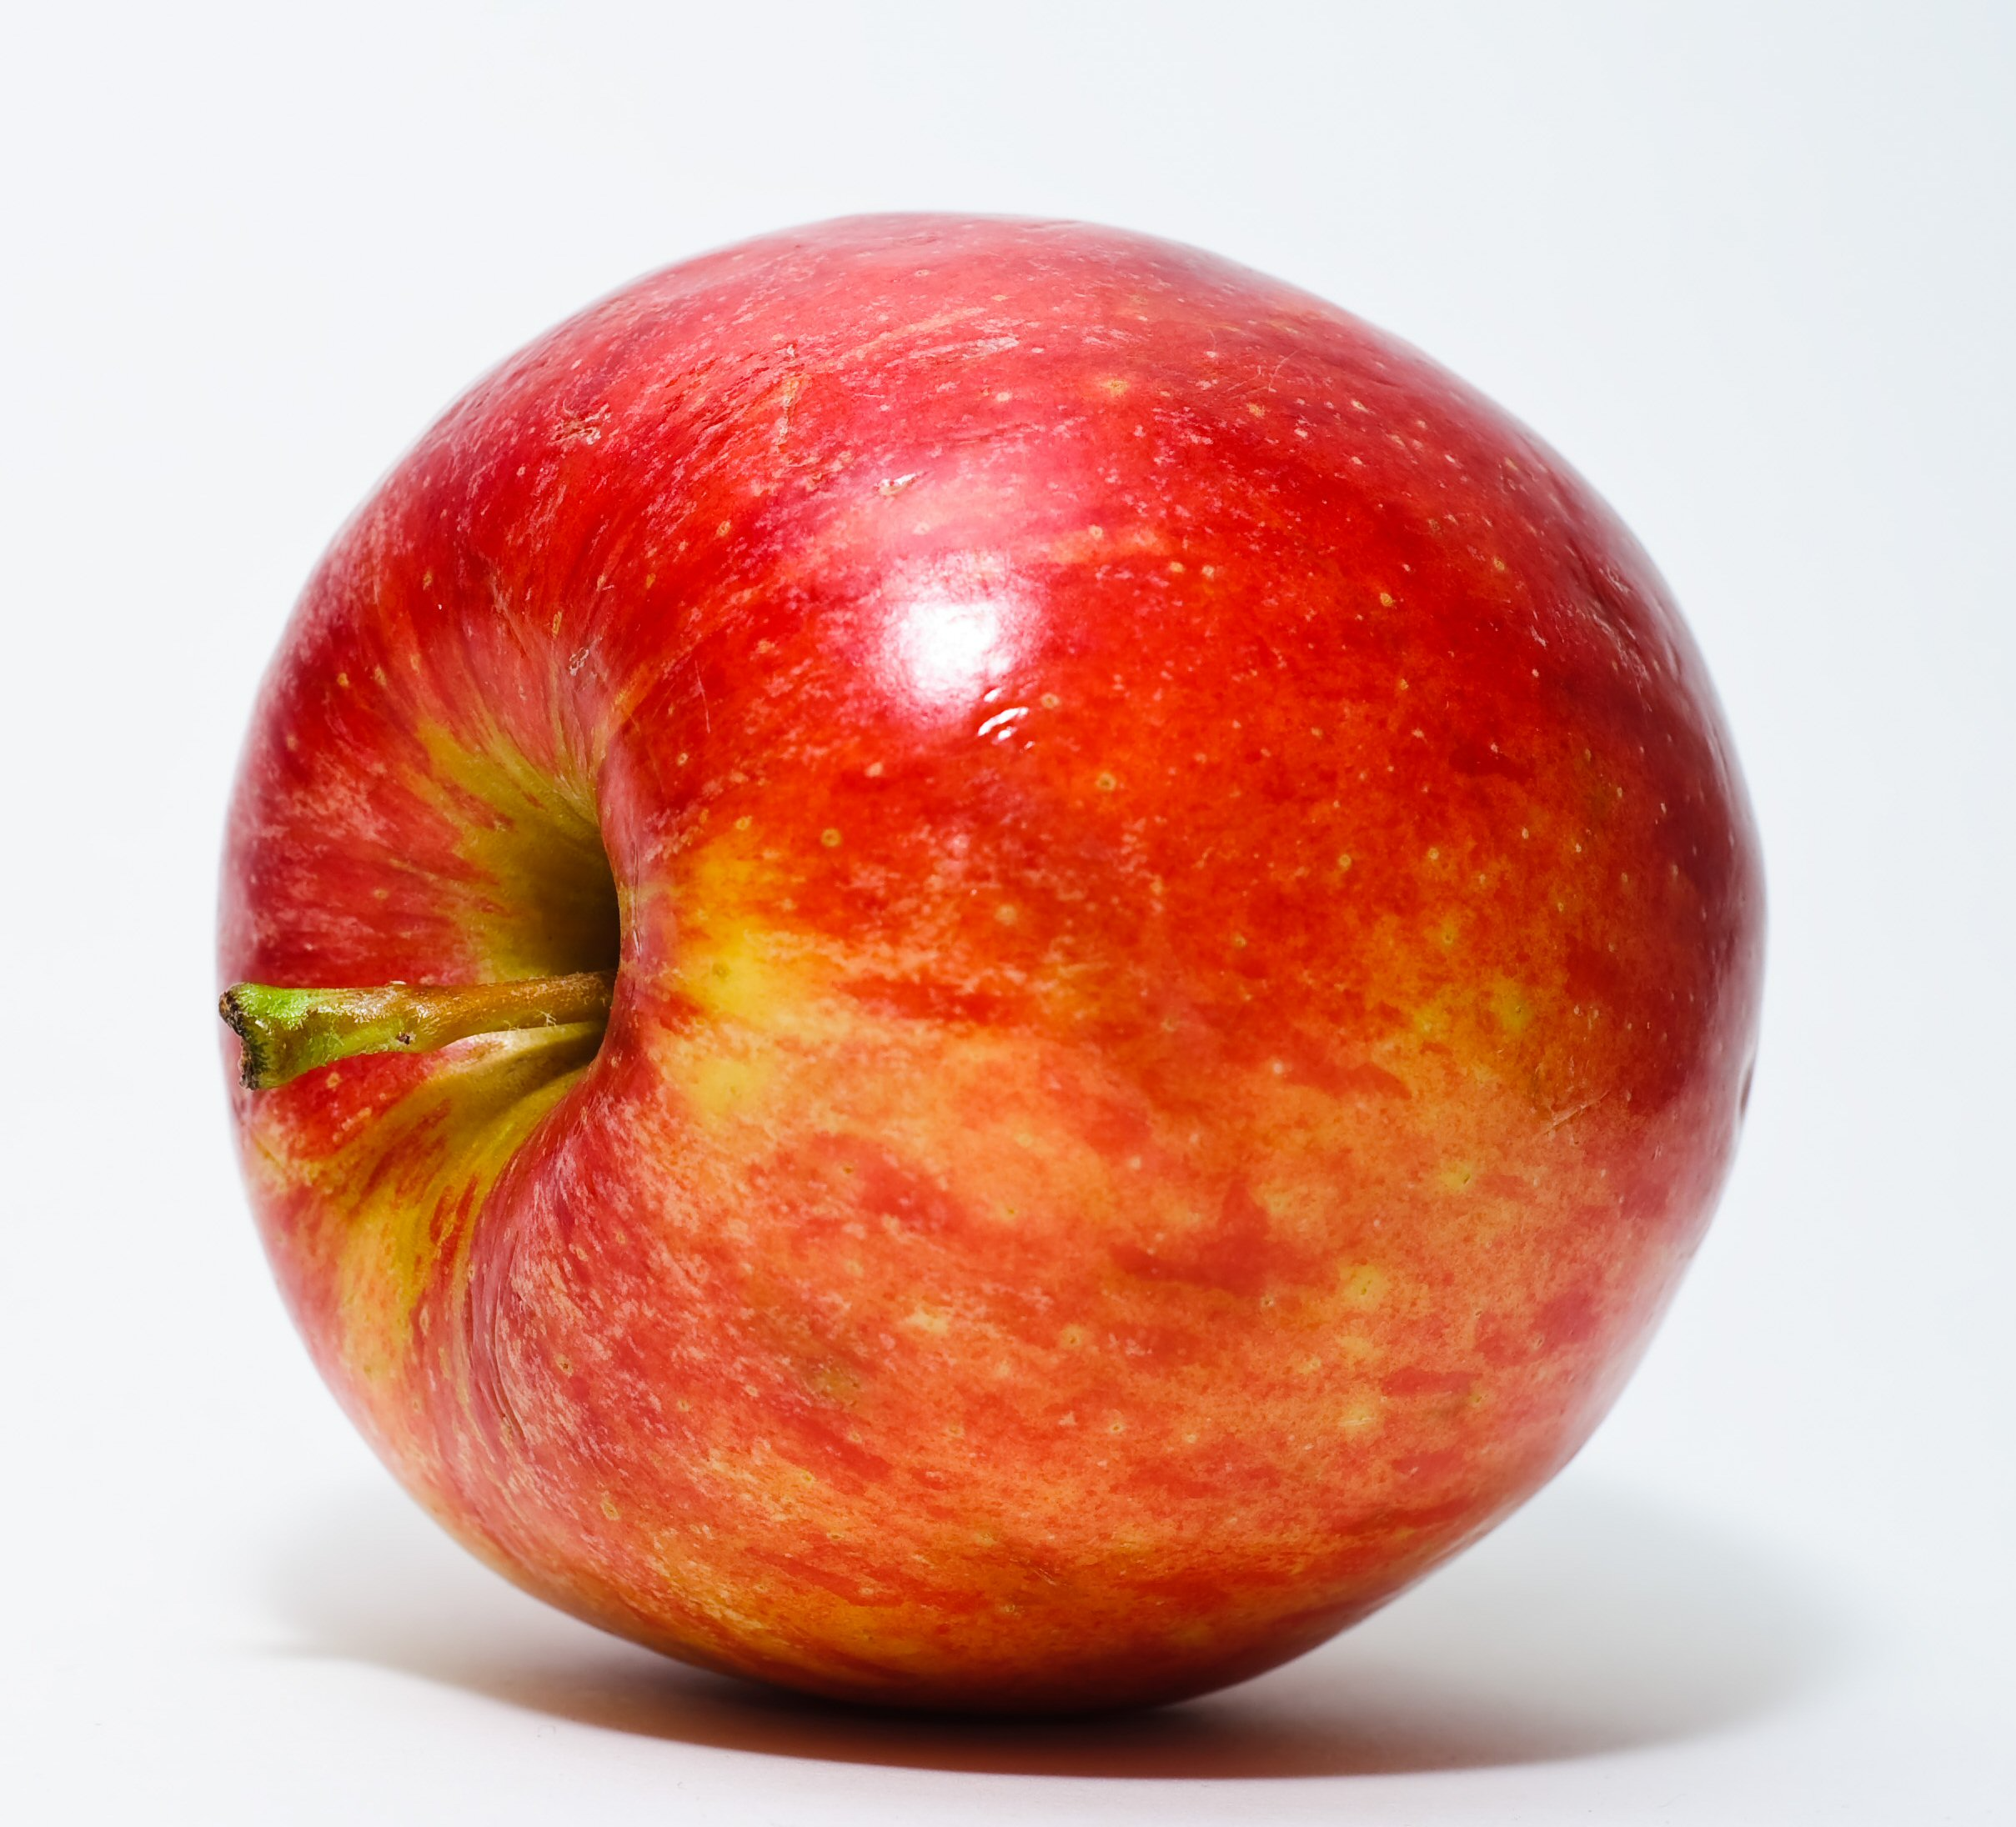
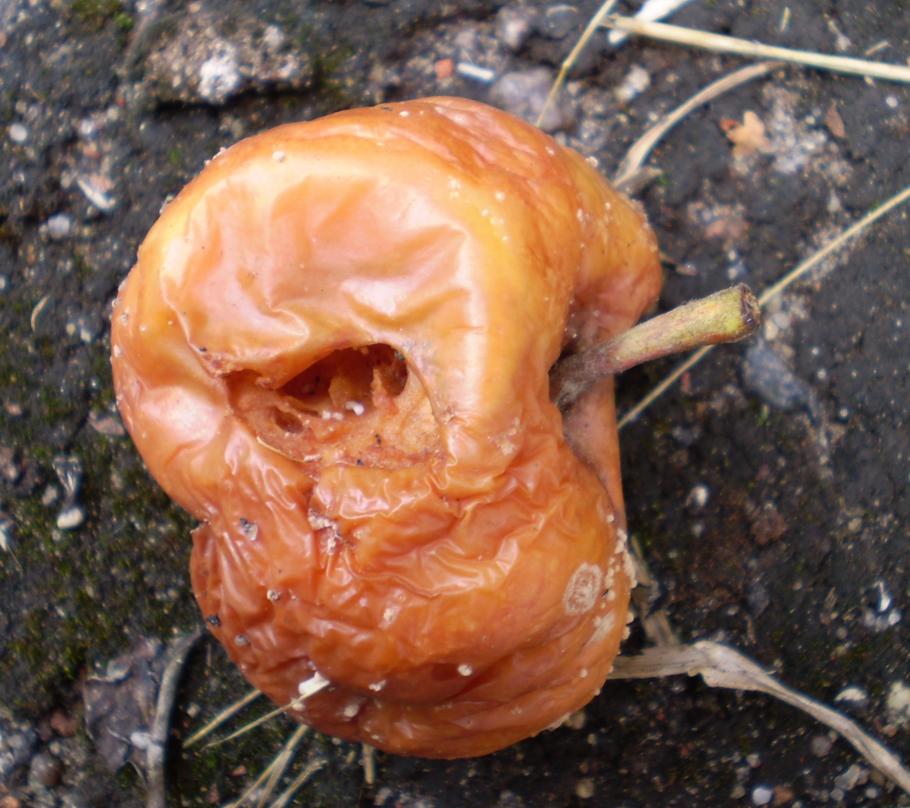
https://commons.wikimedia.org/wiki/File:Red_Apple.jpg Abhijit Tembhekar from Mumbai, India, CC BY 2.0 <https://creativecommons.org/licenses/by/2.0>, via Wikimedia Commons
https://commons.wikimedia.org/wiki/File:Rotten_apple.jpg Kulmalukko, CC BY-SA 3.0 <https://creativecommons.org/licenses/by-sa/3.0>, via Wikimedia Commons
© 2025 Baylor College of Medicine. Field Test Version: Do not distribute, photocopy, or forward this document for use at other locations

