Slide 1
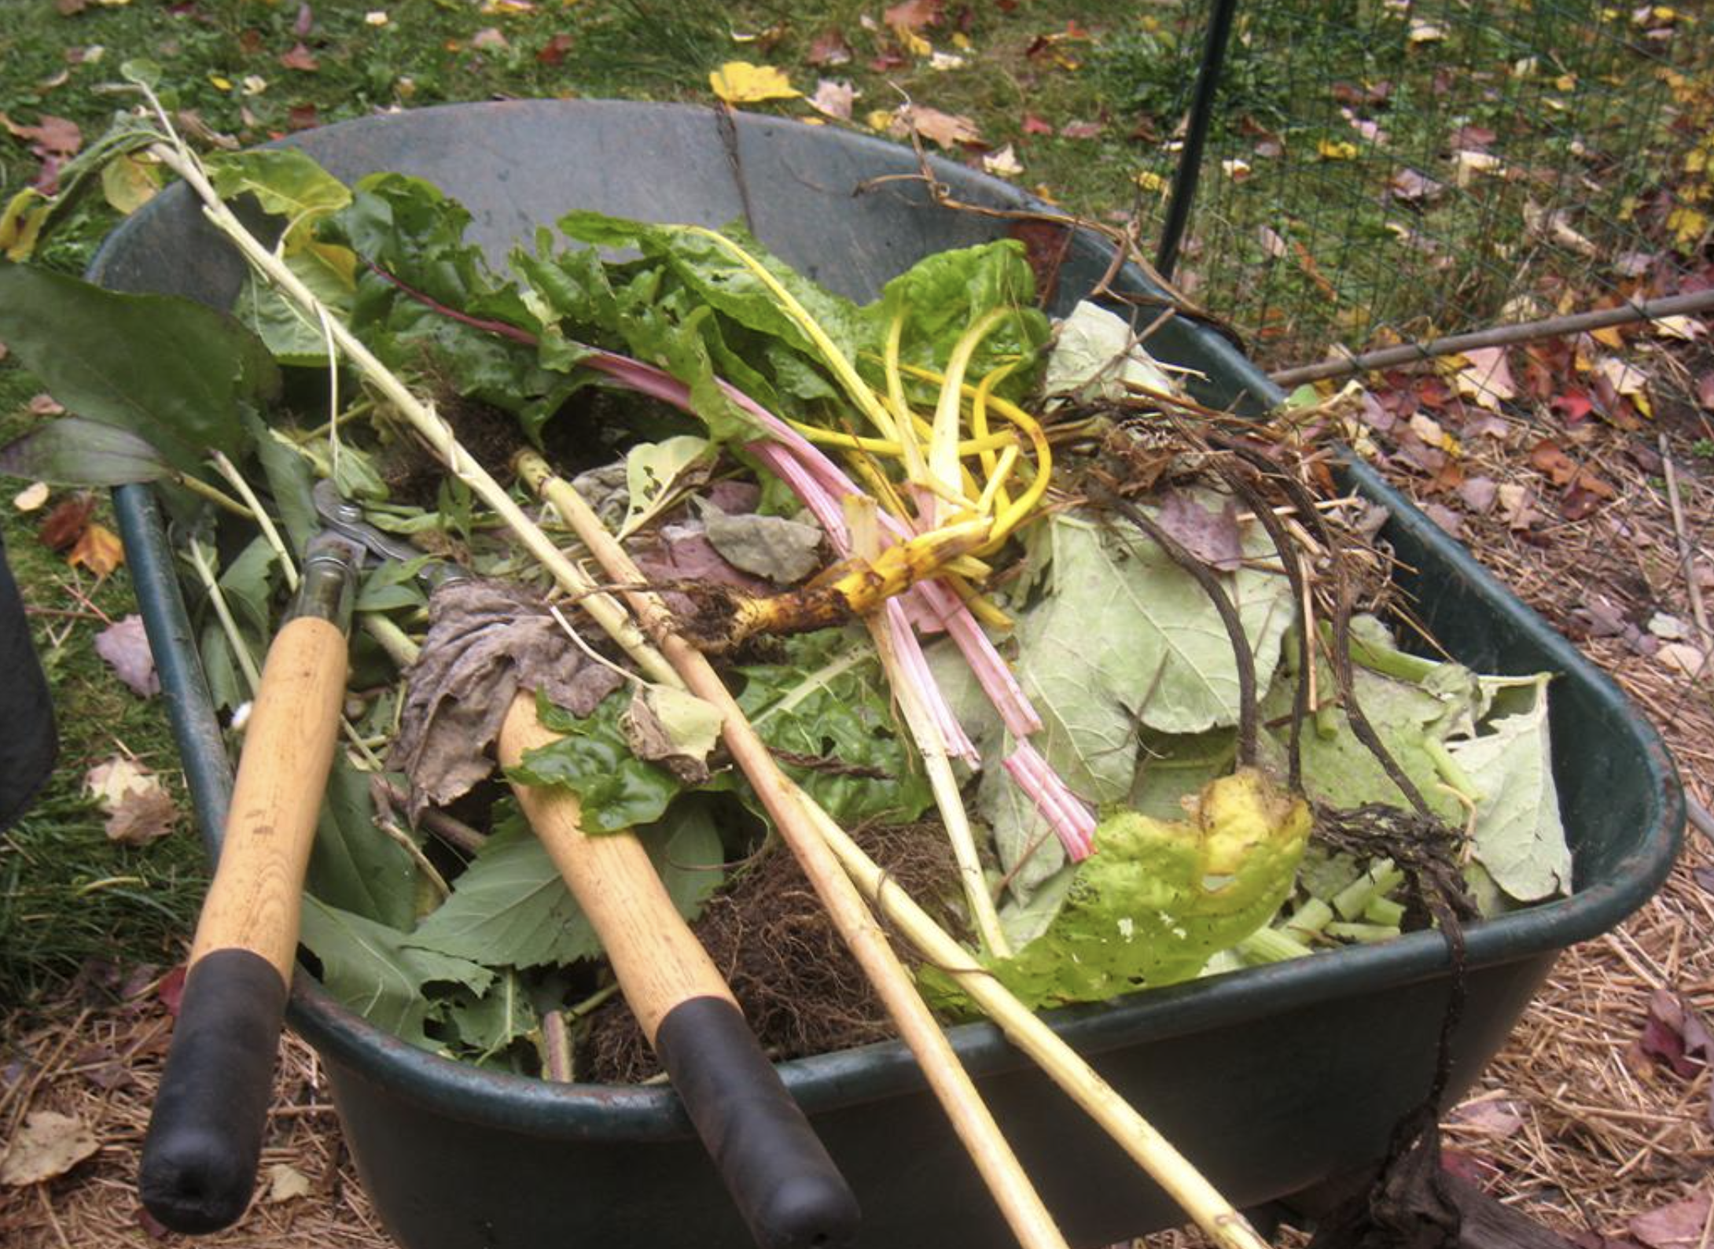
Landfill or Compost?
Managing Solid Waste
"October 20 2007" by brotherM is licensed under CC BY-NC-ND 2.0.
© 2025 Baylor College of Medicine. Field Test Version: Do not distribute, photocopy, or forward this document for use at other locations

Slide 2
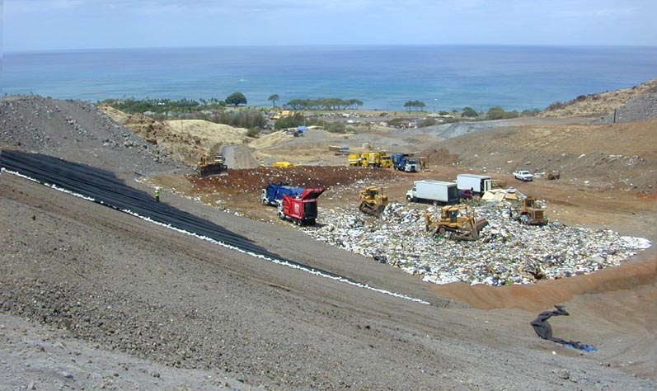
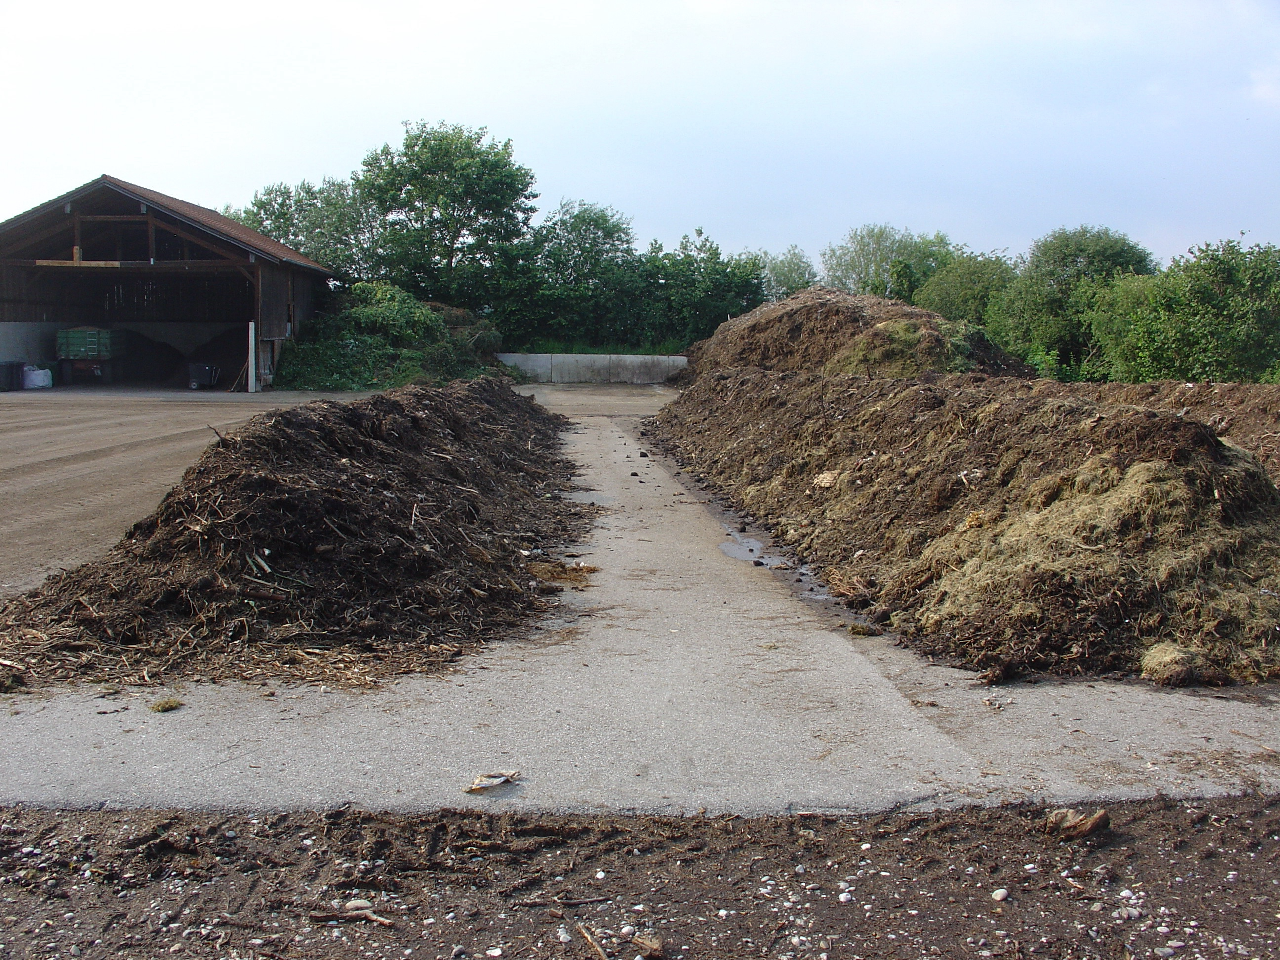
Landfill | Composting
Organic and inorganic waste is collected and buried together in layers in a “cell” or hole. Hole is completely sealed to protect ground and surface water from contaminants that seep from and through the waste. | Organic waste is collected and mixed regularly. Contamination is possible from liquid that seeps from organic waste in larger-scale facilities.
https://commons.wikimedia.org/wiki/File:Landfill_Hawaii.jpg Eric Guinther, CC BY-SA 3.0 <http://creativecommons.org/licenses/by-sa/3.0/>, via Wikimedia Commons
https://commons.wikimedia.org/wiki/File:Compost_site_germany.JPG Crystalclear, CC BY-SA 3.0
<http://creativecommons.org/licenses/by-sa/3.0/>, via Wikimedia Commons

Slide 3
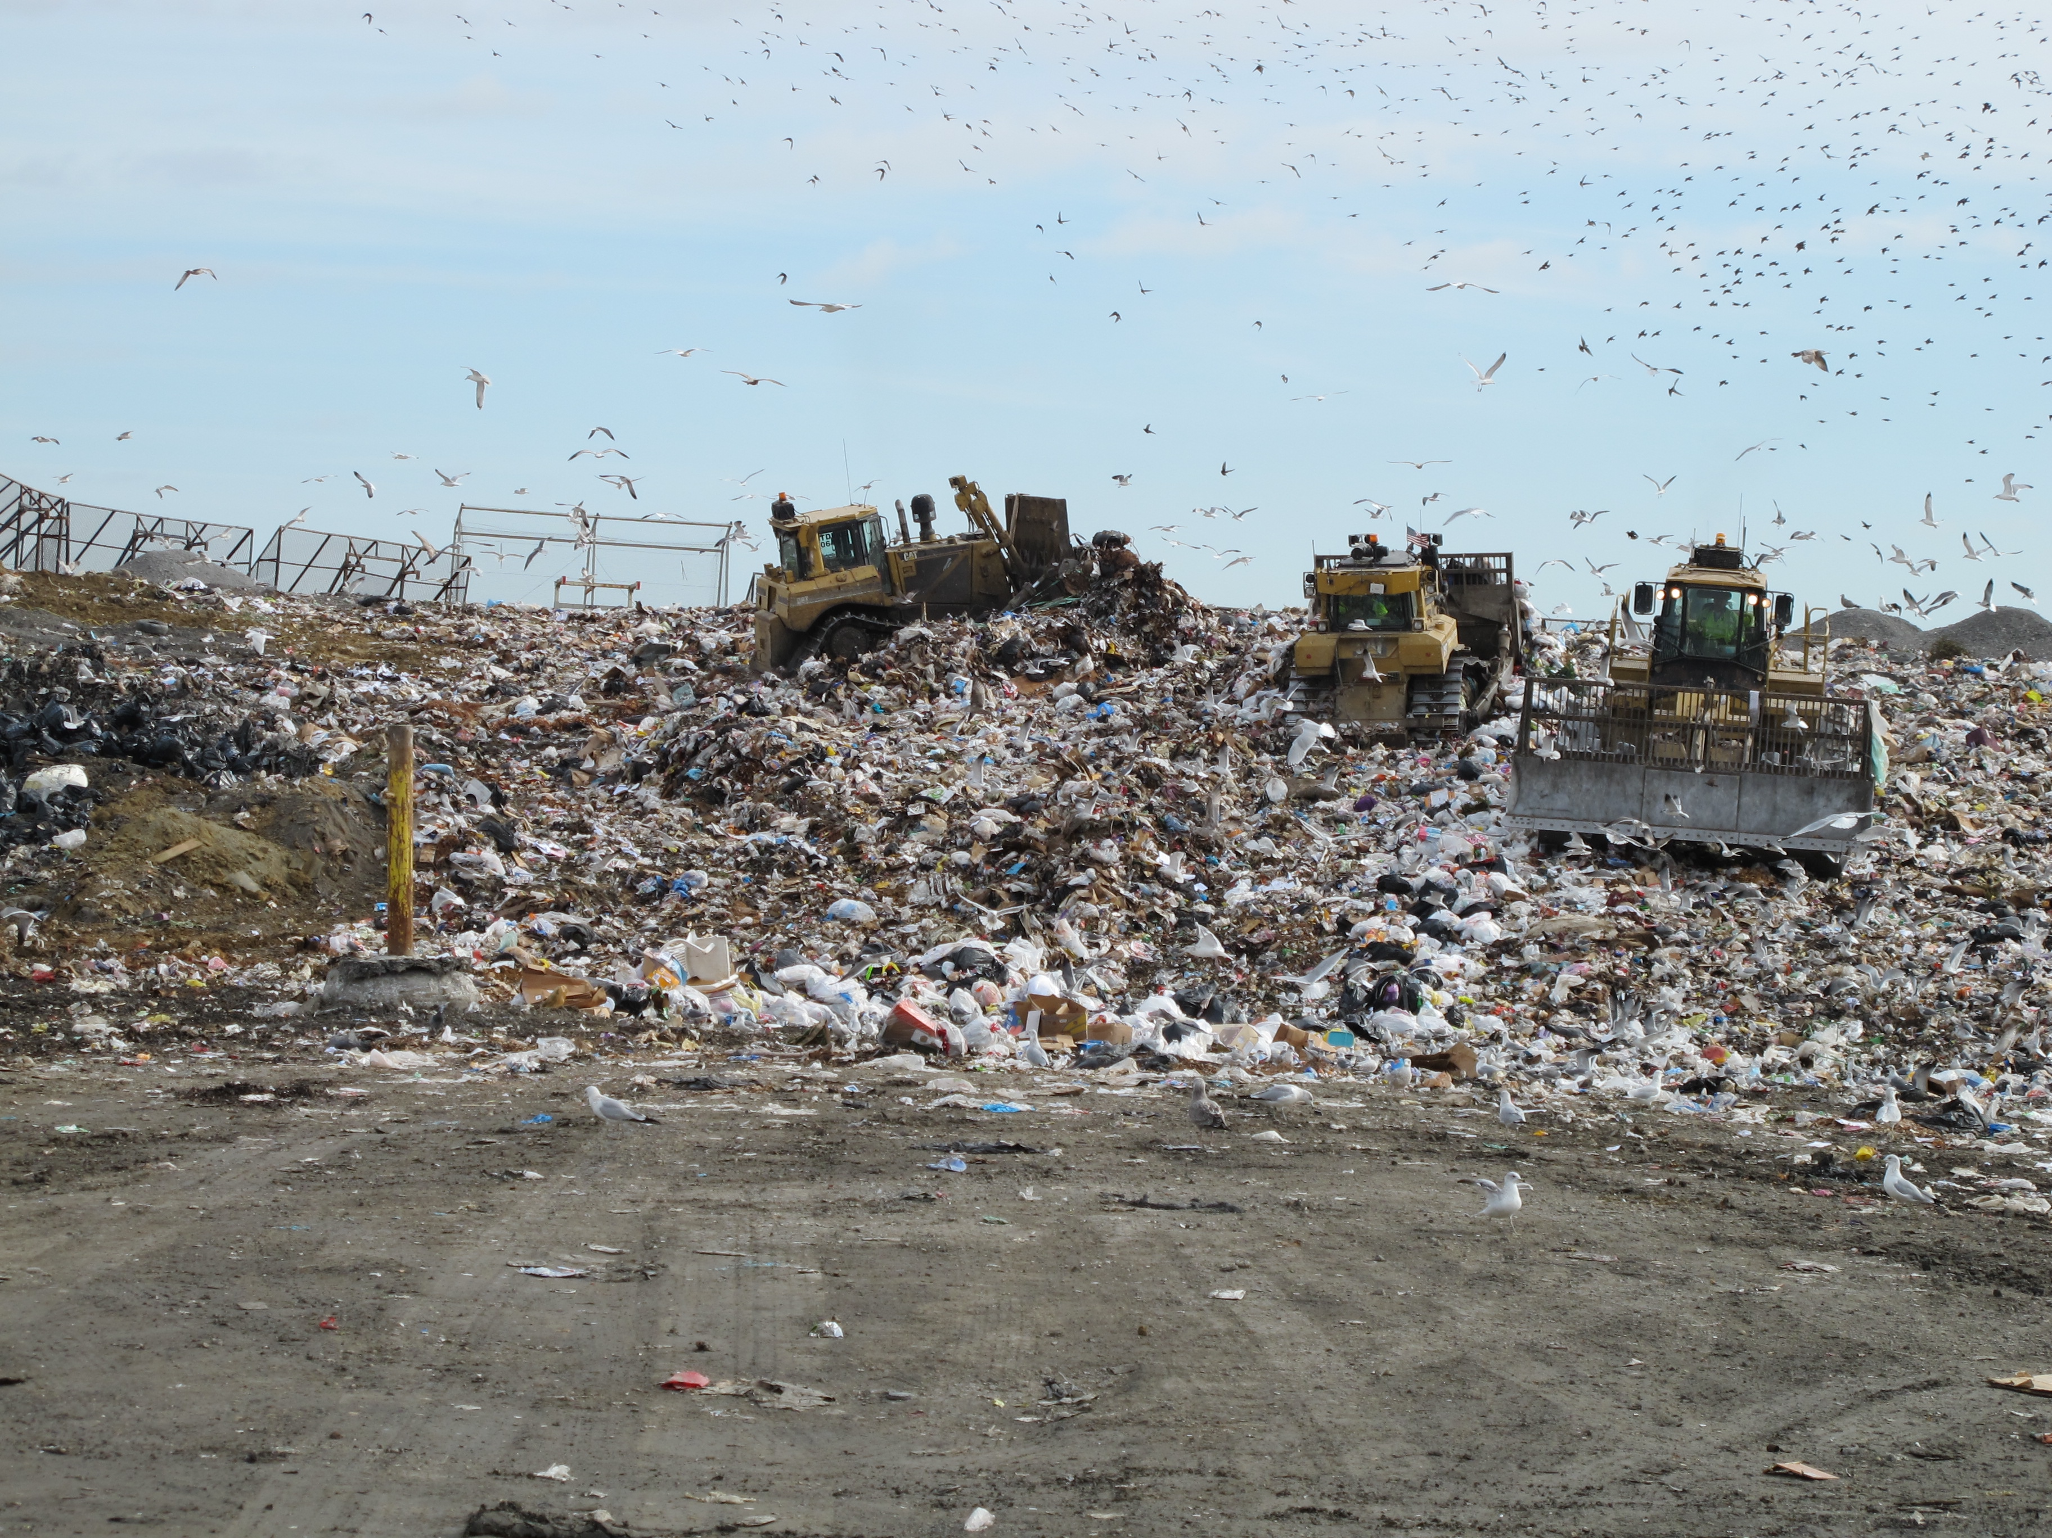
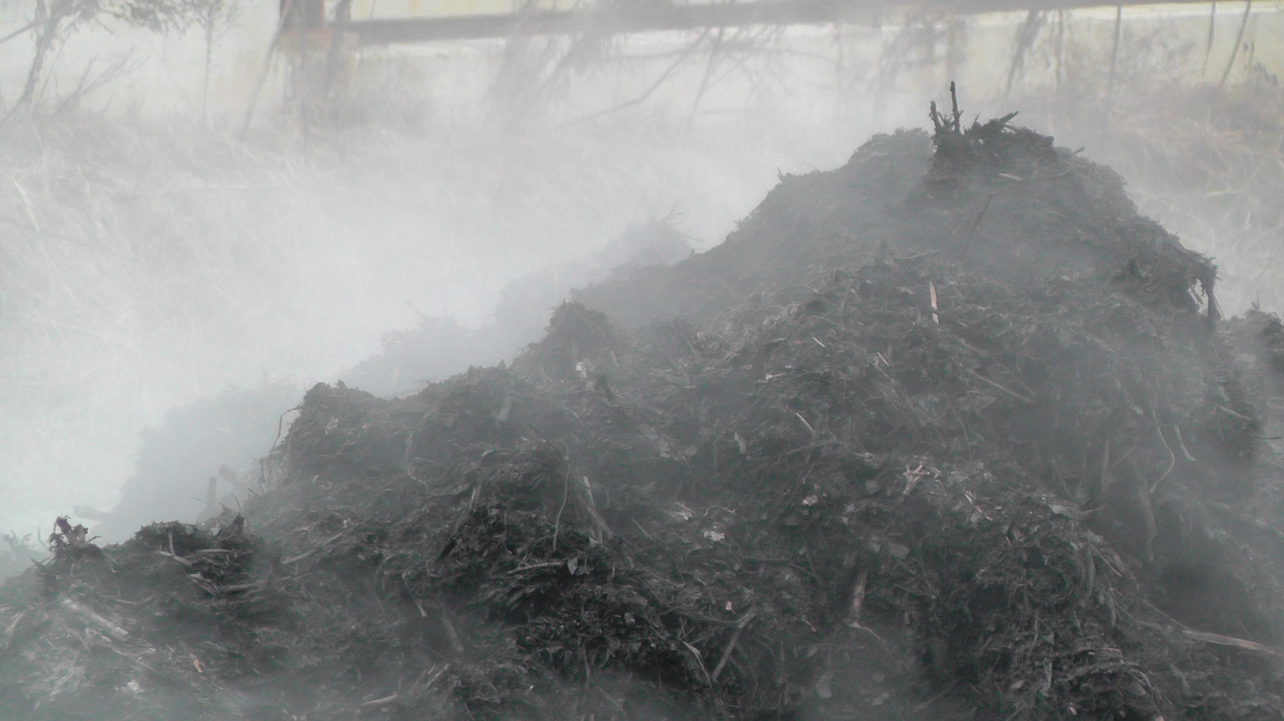
Landfill | Composting
Decomposition by microorganisms occurs slowly in the absence of oxygen. Valuable nutrients from organic matter are not recoverable. | Decomposition by microorganisms occurs more quickly in the presence of oxygen. Recycles organic matter and nutrients and enriches the soil.
https://commons.wikimedia.org/wiki/File:Compost_site_germany. JPG Crystalclear, CC BY-SA 3.0 <http://creativecommons.org/licenses/by-sa/3.0/>, via Wikimedia Commons
https://commons.wikimedia.org/wiki/File:Compost_steaming_-_detail_3.jpg Lucabon, CC BY-SA 4.0 <https://creativecommons.org/licenses/by-sa/4.0>, via Wikimedia Commons

Slide 4
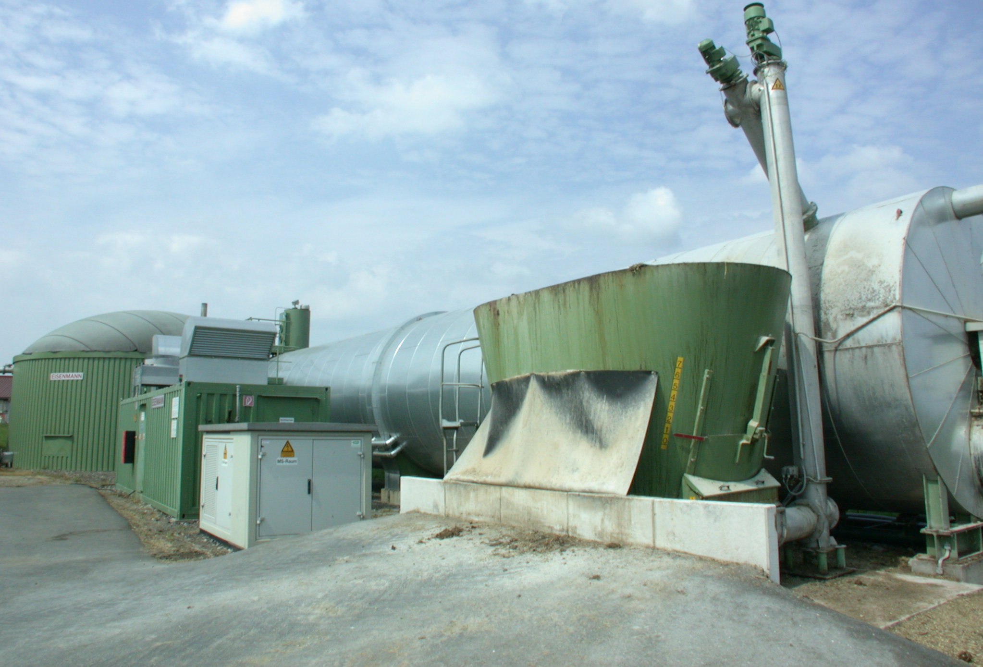
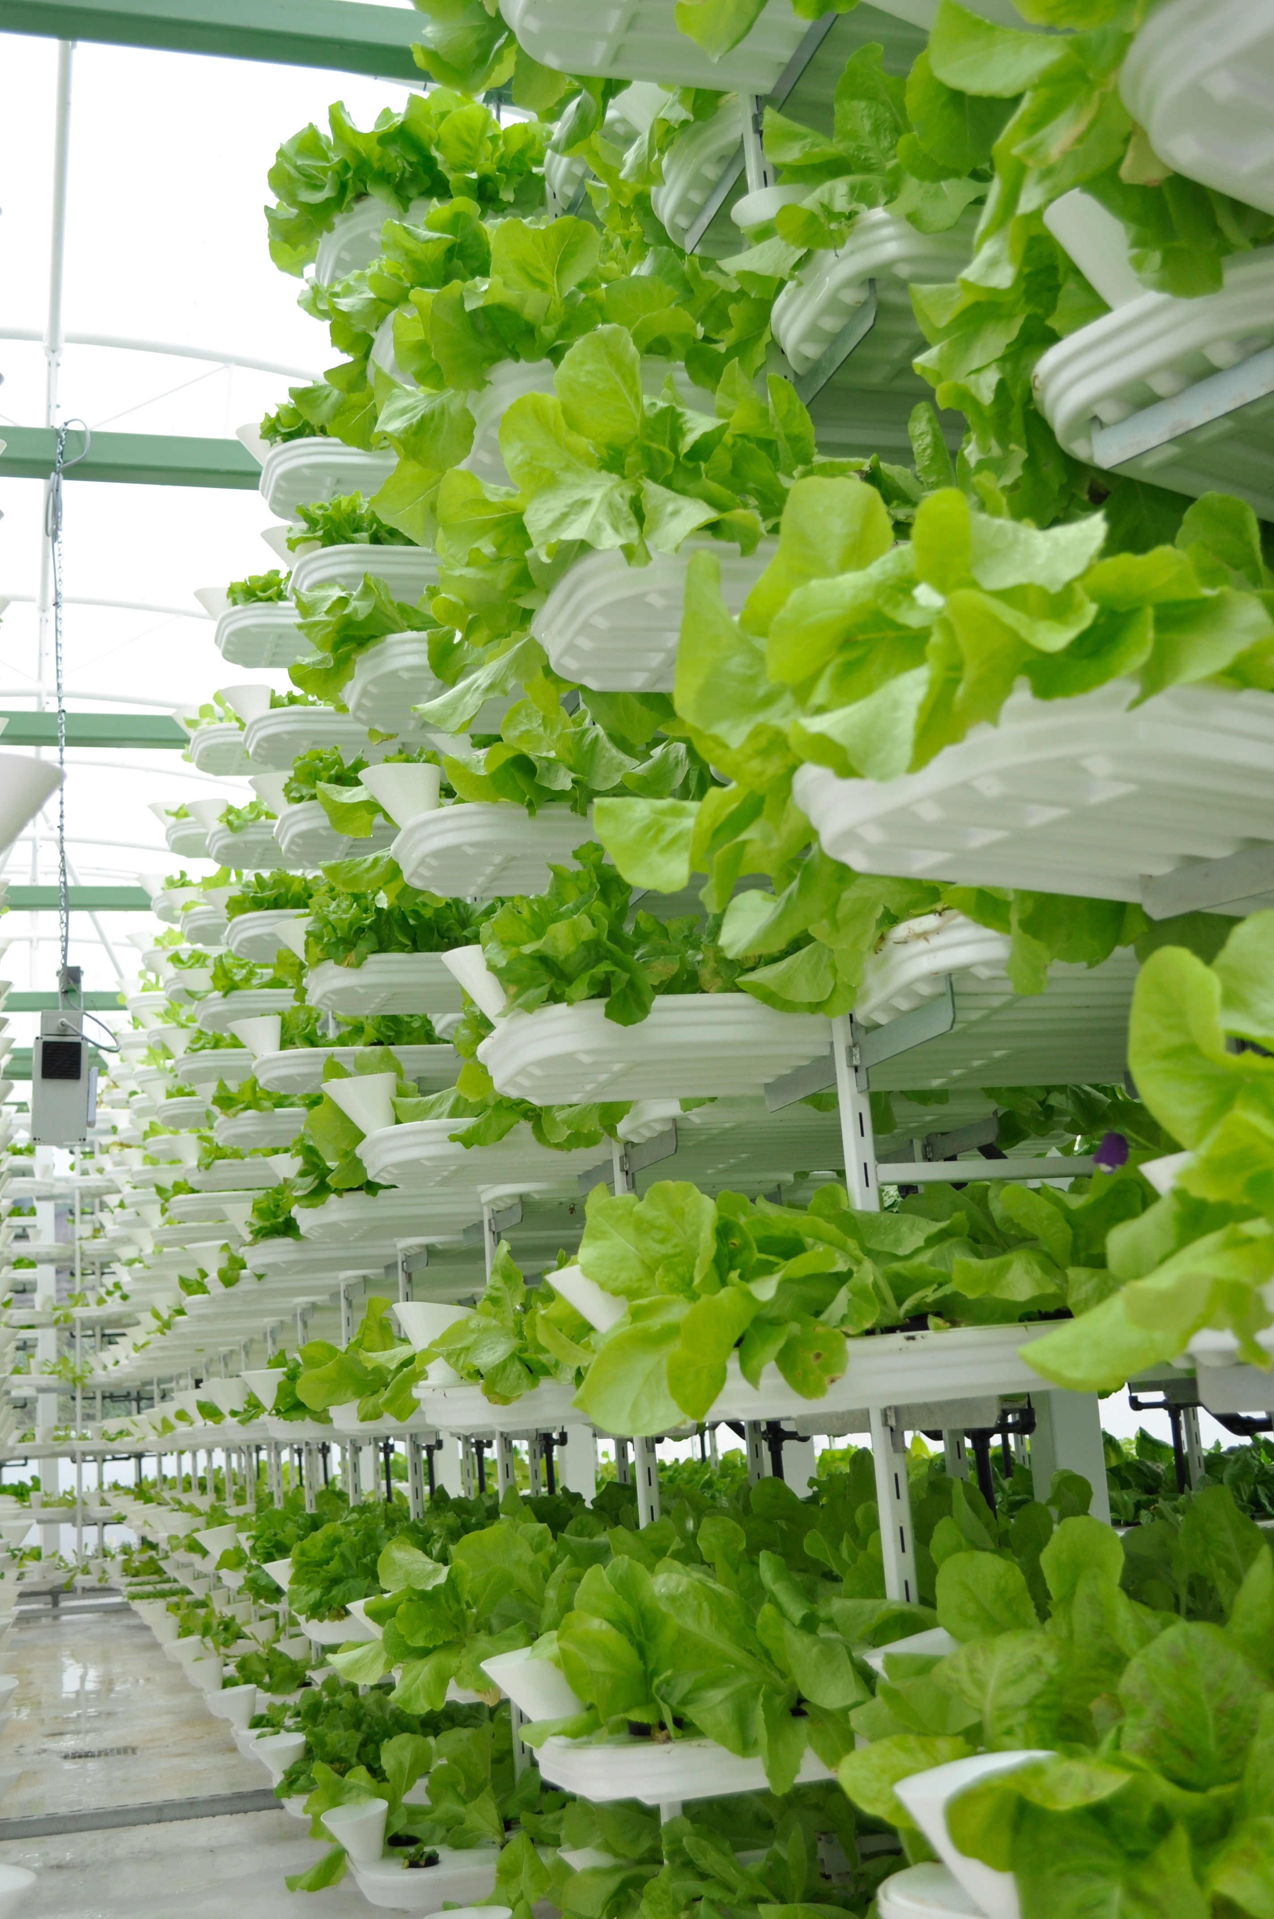
Landfill | Composting
Decomposition produces less carbon dioxide gas but more methane gas. Managed properly, methane can be used as renewable energy. | Decomposition produces more carbon dioxide but less methane gas. Carbon dioxide emissions can be recaptured and used for plant production in controlled environments.
https://commons.wikimedia.org/wiki/File:Biogas.jpg Volker Thies (Asdrubal), CC BY-SA 3.0 <http://creativecommons.org/licenses/by-sa/3.0/>, via Wikimedia Commons
https://commons.wikimedia.org/wiki/File:VertiCrop.jpg Valcenteu, CC BY-SA 3.0 <https://creativecommons.org/licenses/by-sa/3.0>, via Wikimedia Commons

Slide 5
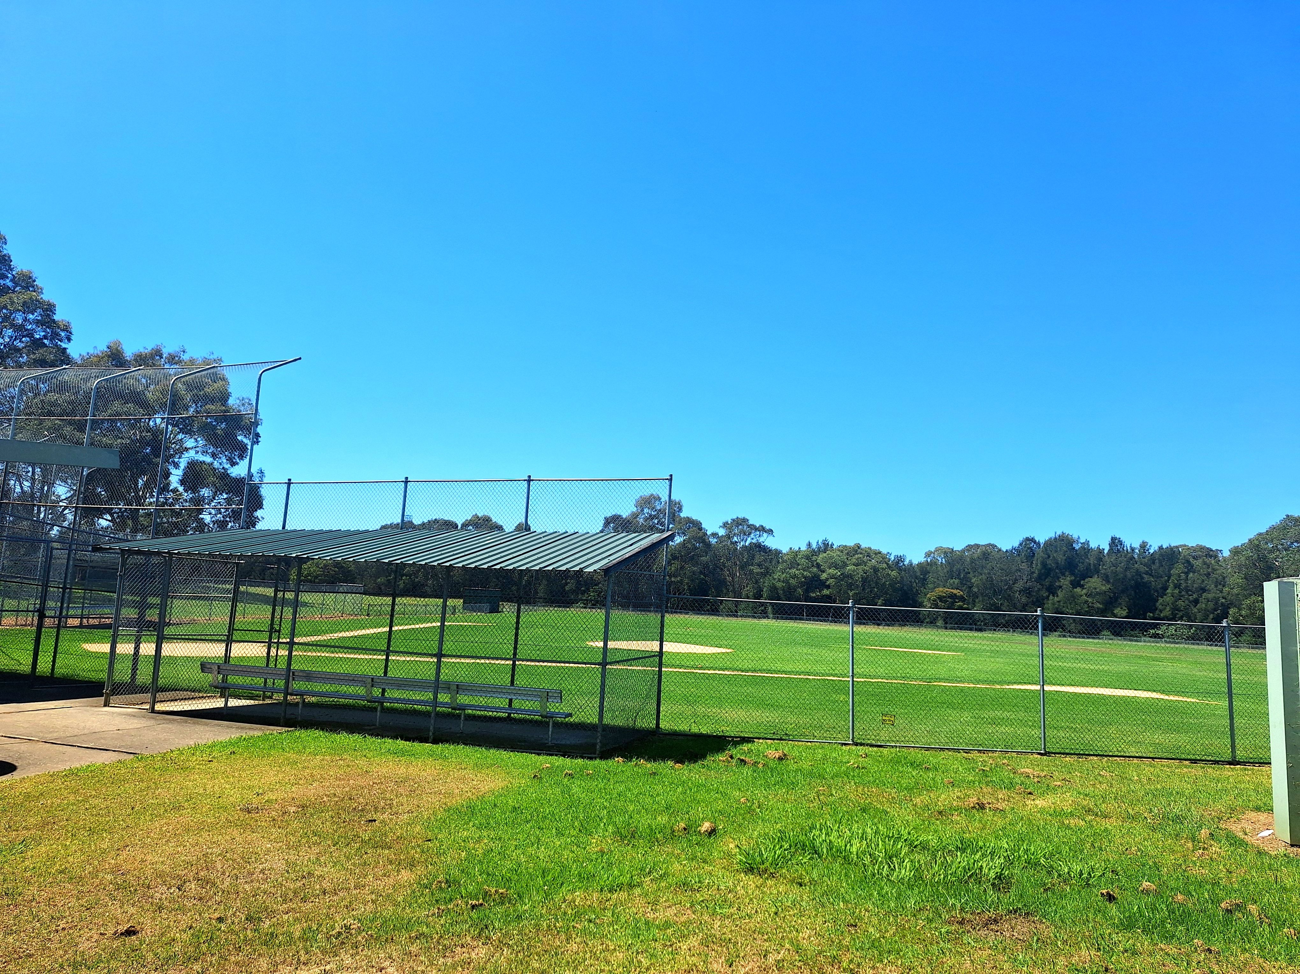
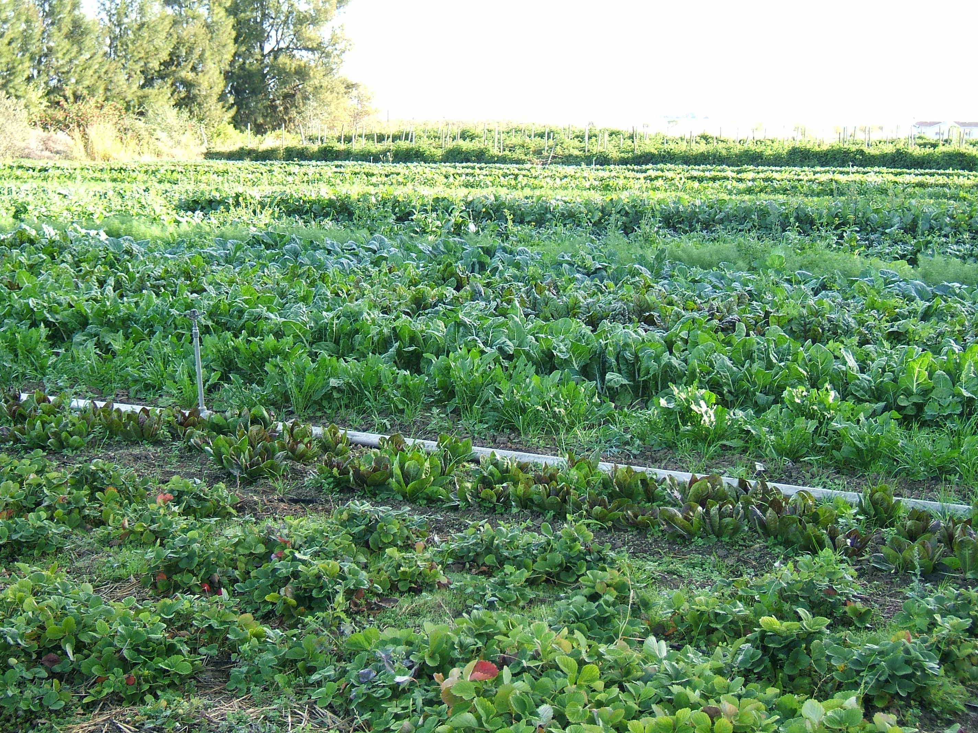
Landfill | Composting
With careful planning and safe cleanups, these areas can be converted into recreational areas or commercial sites. | Enriches the health of soil to enhance plant growth, reducing the need for chemical fertilizers in agriculture and gardening.
https://commons.wikimedia.org/wiki/File:Gipps_Road_Sporting_Complex_baseball_oval.jpg
Yucalyptus, CC0, via Wikimedia Commons
https://commons.wikimedia.org/wiki/File:Organic-vegetable-cultivation.jpeg Hajhouse, Public domain, via Wikimedia Commons

Slide 6
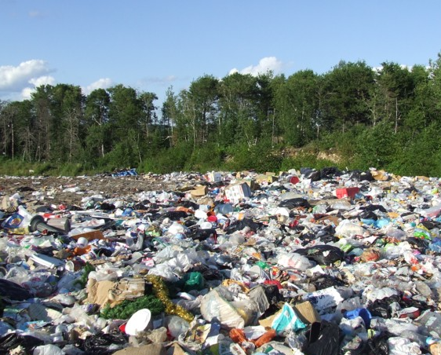
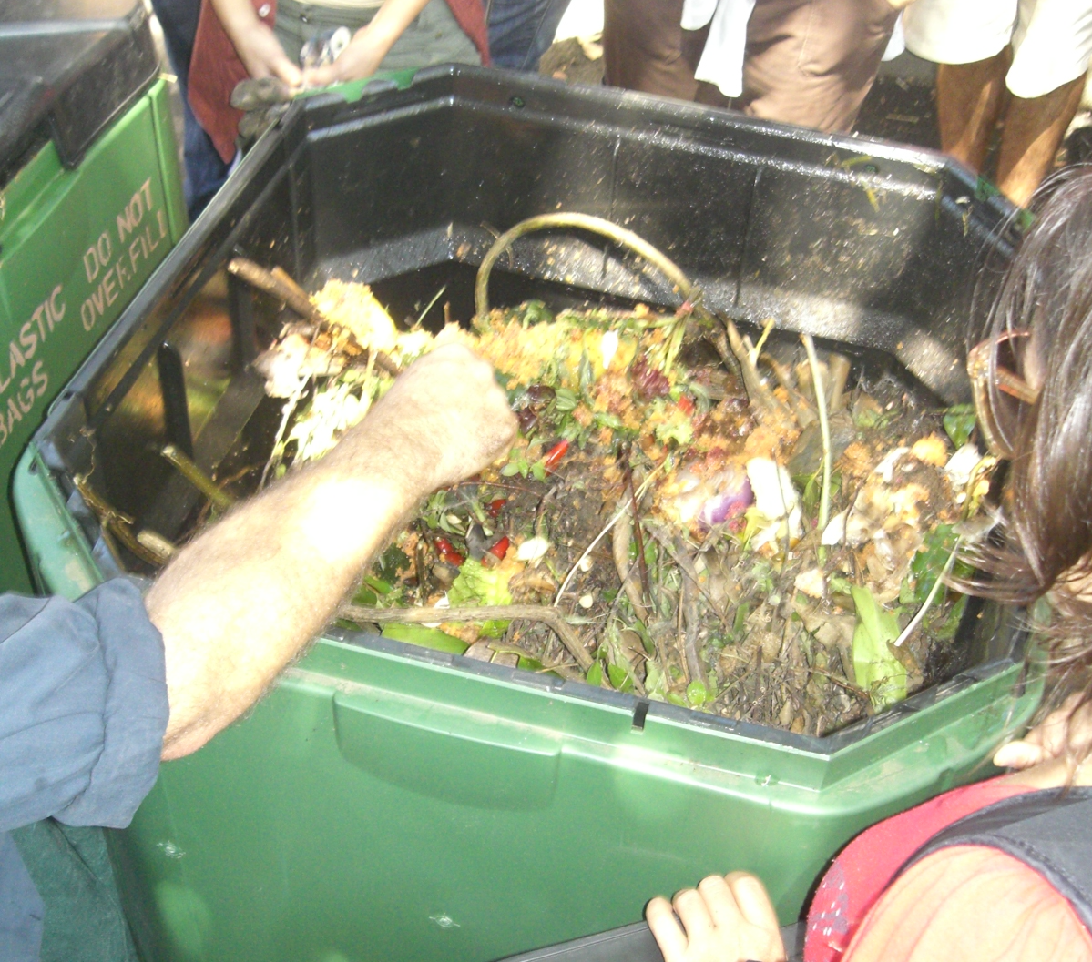
Landfill | Composting
Requires a large area or facility. | Can be done on a large scale or small scale.
https://commons.wikimedia.org/wiki/File:Landfill.jpg Dhscommtech at English Wikipedia, CC BY-SA 3.0 <https://creativecommons.org/licenses/by-sa/3.0>, via Wikimedia Commons
https://commons.wikimedia.org/wiki/File:Compost_bin_image.jpg Steven Parker, CC BY 2.0 <https://creativecommons.org/licenses/by/2.0>, via Wikimedia Commons

