Slide 1
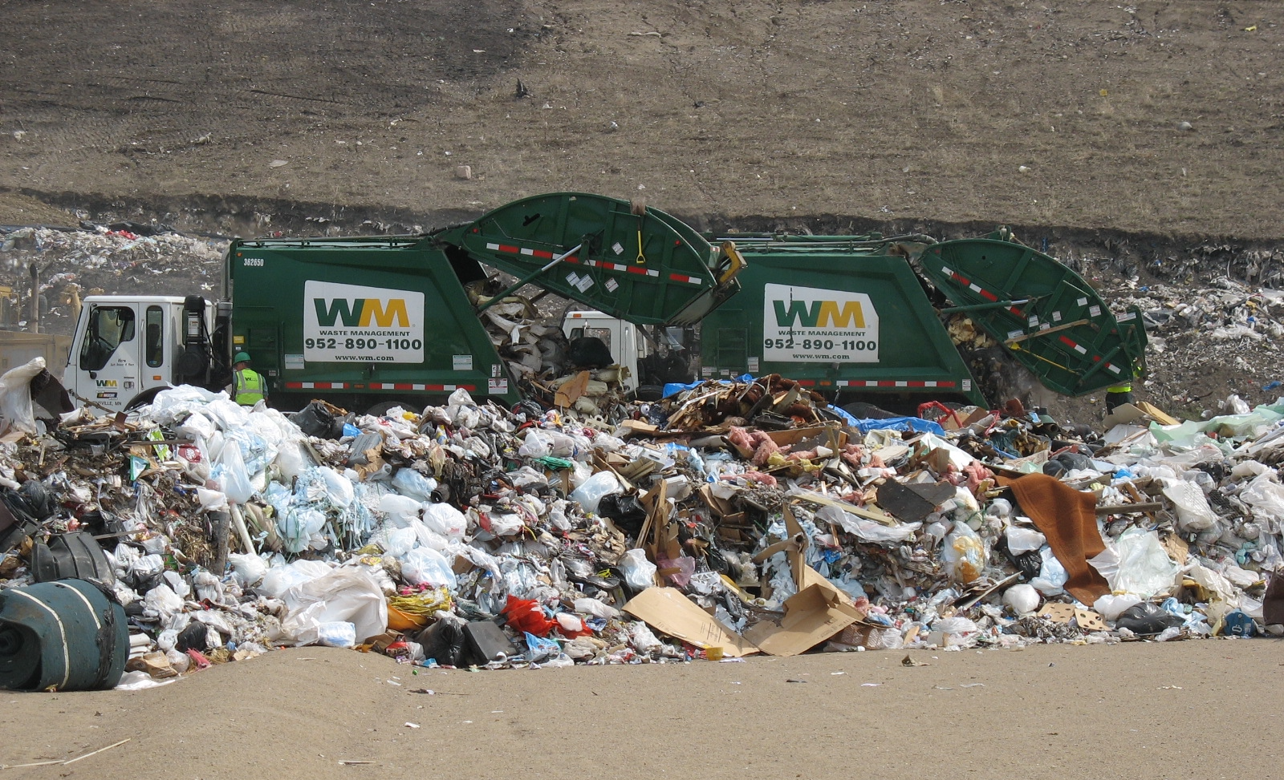
Landfill
https://commons.wikimedia.org/wiki/File:At_the_landfill.jpg Redwin Law, CC BY 2.0 <https://creativecommons.org/licenses/by/2.0>, via Wikimedia Commons
© 2025 Baylor College of Medicine. Field Test Version: Do not distribute, photocopy, or forward this document for use at other locations.

