Slide 1
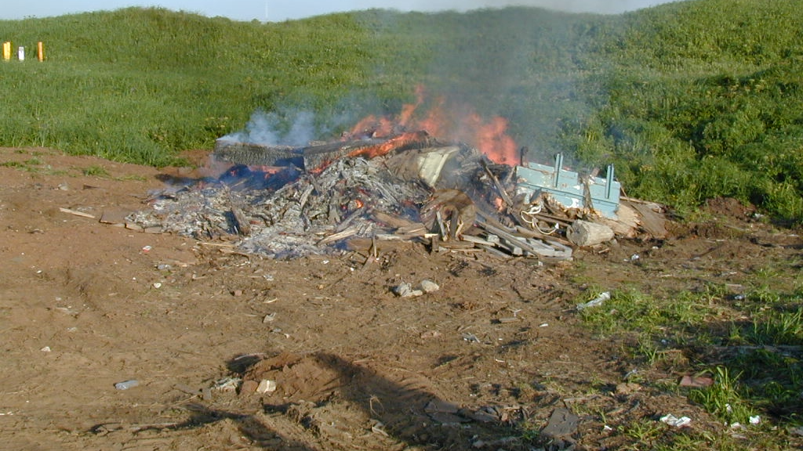
https://commons.wikimedia.org/wiki/File:Miscellaneous--St._Paul_-_DPLA_-_3aa3ba5e17814fcb57141e225b1327ba.jpg National Archives at College Park - Still Pictures, Public domain, via Wikimedia Commons

