Slide 1
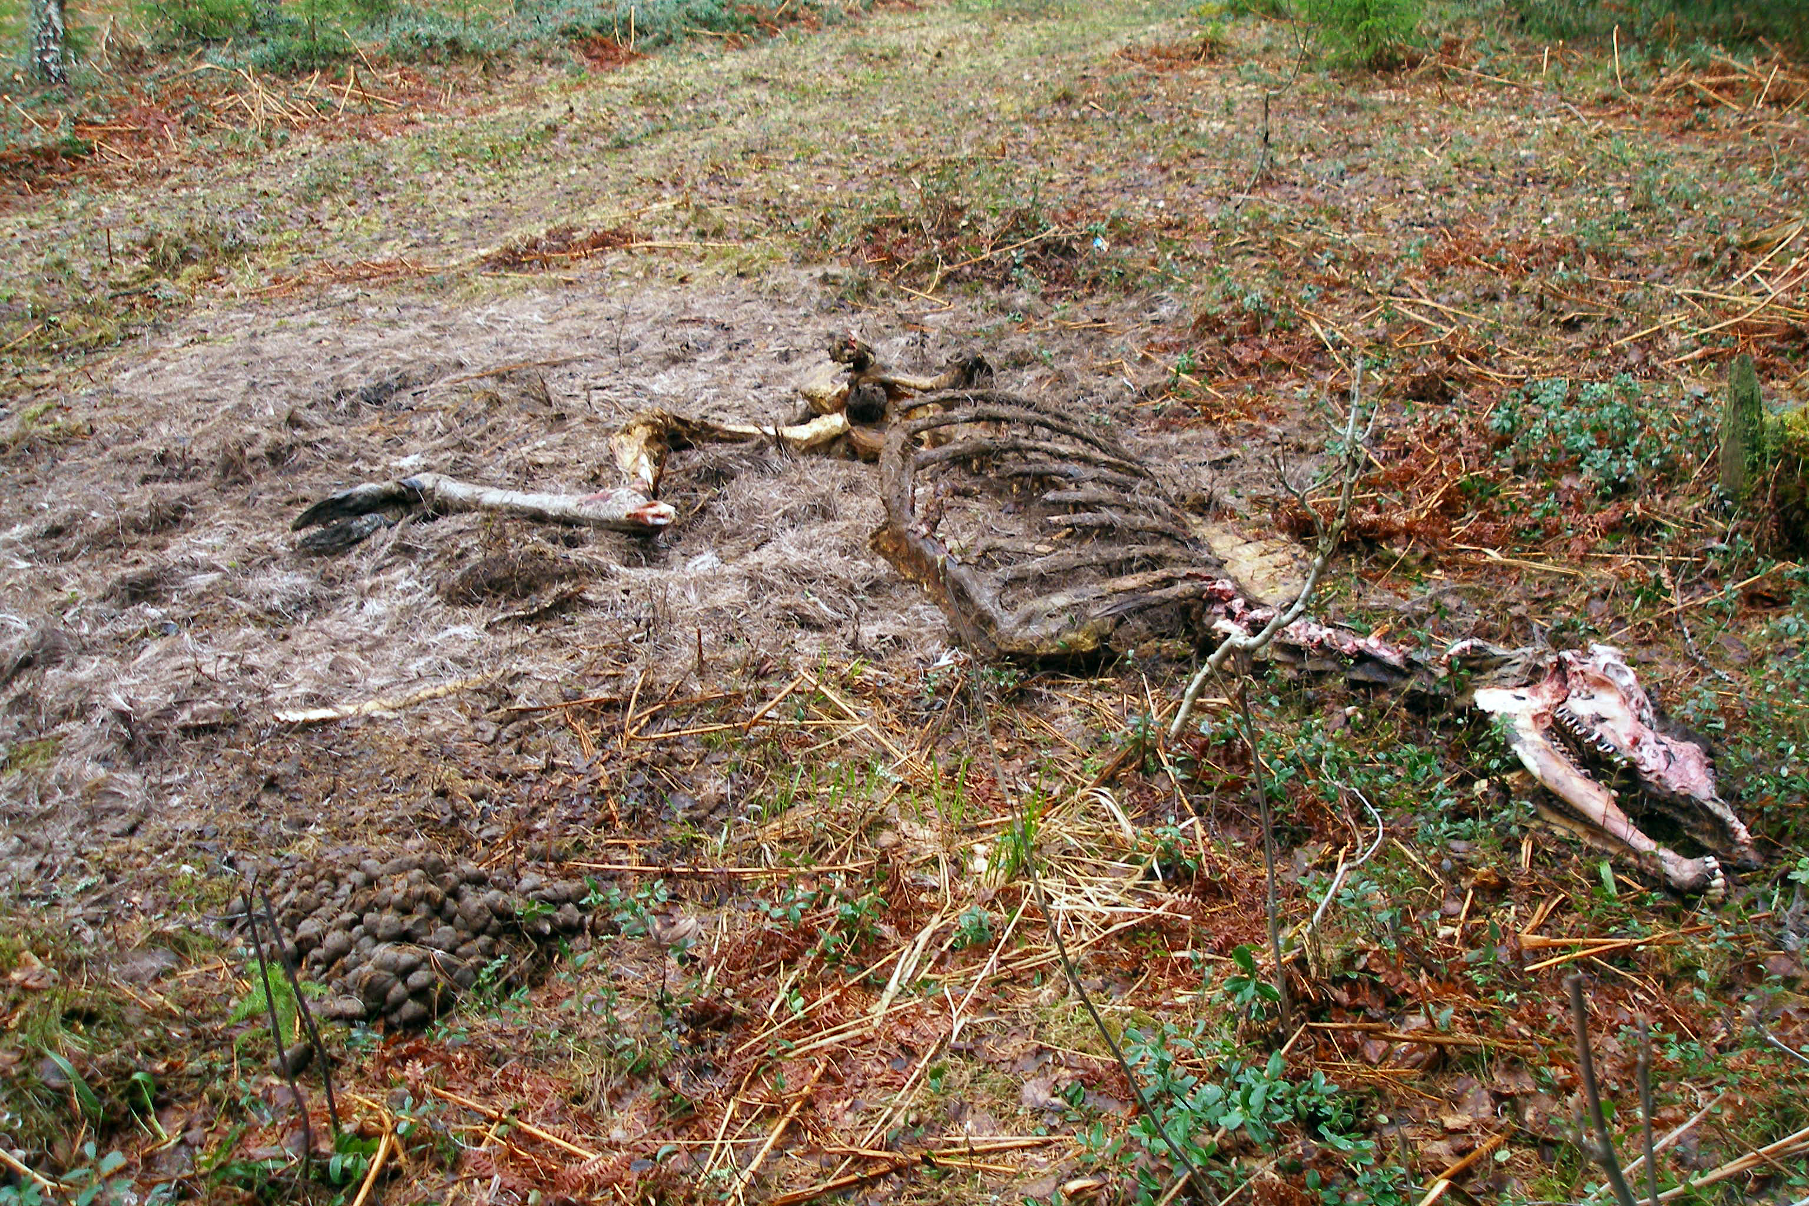
What happened to this animal when it died?
https://commons.wikimedia.org/wiki/File:Alce_(Alces_alces),_Potter_marsh,_Alaska,_Estados_Unidos,_2017-08-22,_DD_139.jpg Diego Delso, CC BY-SA 4.0 <https://creativecommons.org/licenses/by-sa/4.0>, via Wikimedia Commons
https://commons.wikimedia.org/wiki/File:Carcasse_of_a_moose,_May_2010.jpg Hannu, Public domain, via Wikimedia Commons.
© 2025 Baylor College of Medicine. Field Test Version: Do not distribute, photocopy, or forward this document for use at other locations.
Notes:
\

