Slide 1
Day 12 Plant Fossils

Slide 2
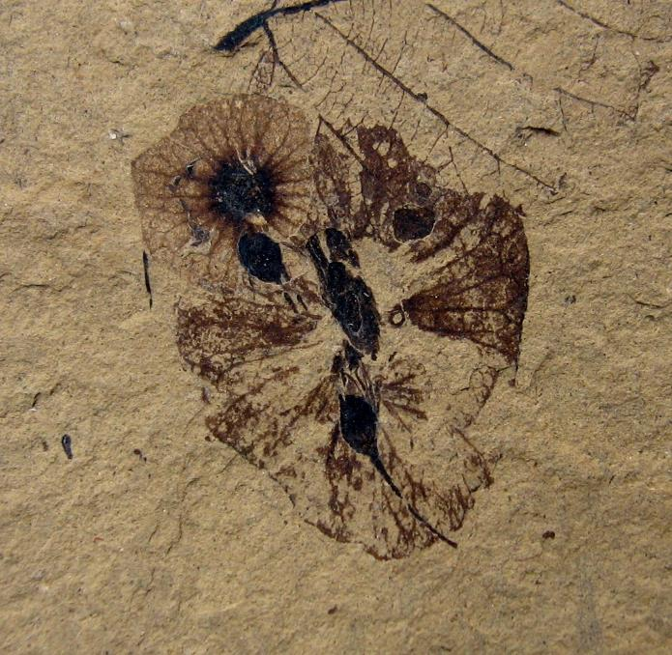
Fossil 1
Approximate fossil time period: 49.5 MYA.
Note the darkened areas.
Notes:
URL: https://commons.wikimedia.org/wiki/File:Dillhoffia_cachensis_SR_92-17-20_1.jpg
Attribution: Kevmin, CC BY-SA 3.0 <https://creativecommons.org/licenses/by-sa/3.0>, via Wikimedia Commons

Slide 3
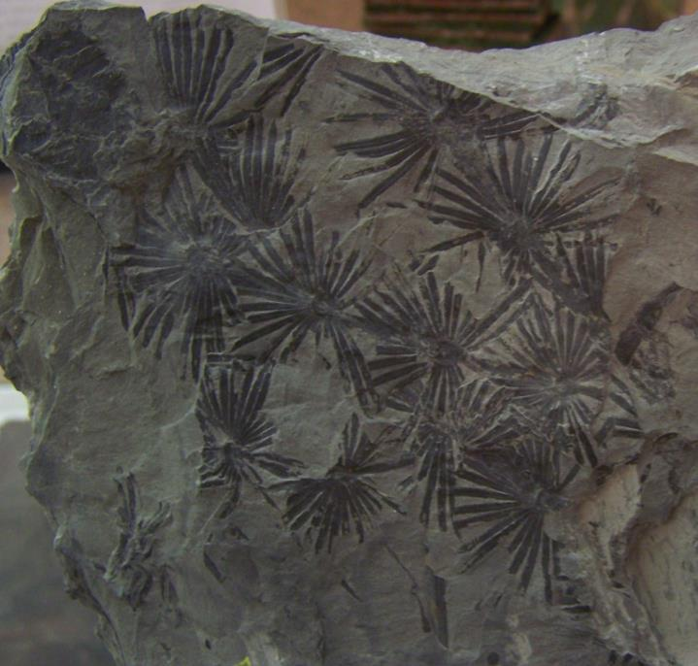
Fossil 2
Approximate fossil time period: 310-280 MYA.
What plant parts are seen?
Notes:
URL: https://commons.wikimedia.org/wiki/File:Annularia_Stellata.jpg
Attribution: Woudloper, Public domain, via Wikimedia Commons

Slide 4
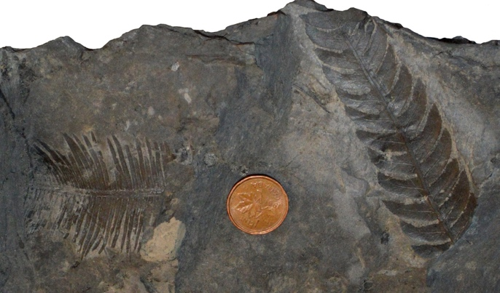
Fossil 3
Approximate fossil time period: 165–00.5 MYA.
Note difference in plant part shapes.
Coin shows scale size.
Notes:
URL: https://commons.wikimedia.org/wiki/File:Early_Cretaceous_Plant_Fossils.jpg
Attribution: Georgialh, CC BY-SA 3.0 <https://creativecommons.org/licenses/by-sa/3.0>, via Wikimedia Commons

Slide 5
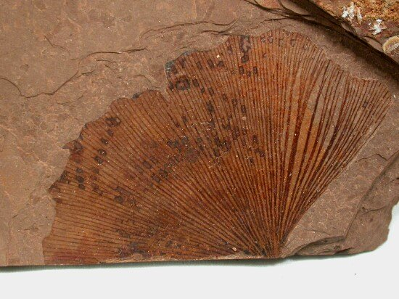
Fossil 4
Approximate fossil time period: 56–33.9 MYA.
What plant part can this be?
Notes:
URL: https://commons.wikimedia.org/wiki/File:Ginkgo_biloba_MacAbee_BC.jpg
Attribution: User:SNP(upload to en:wikipedia) ; User:tangopaso (transfer to Commons), CC BY-SA 3.0 <http://creativecommons.org/licenses/by-sa/3.0/>, via Wikimedia Commons

Slide 6
Figure Cite Key
Figure 1
URL: https://commons.wikimedia.org/wiki/File:Dillhoffia_cachensis_SR_92-17-20_1.jpg
Attribution: Kevmin, CC BY-SA 3.0 <https://creativecommons.org/licenses/by-sa/3.0>, via Wikimedia Commons
Figure 2
URL: https://commons.wikimedia.org/wiki/File:Annularia_Stellata.jpg
Attribution: Woudloper, Public domain, via Wikimedia Commons
Figure 3
URL: https://commons.wikimedia.org/wiki/File:Early_Cretaceous_Plant_Fossils.jpg
Attribution: Georgialh, CC BY-SA 3.0 <https://creativecommons.org/licenses/by-sa/3.0>, via Wikimedia Commons
Figure 4
URL: https://commons.wikimedia.org/wiki/File:Ginkgo_biloba_MacAbee_BC.jpg
Attribution: User:SNP(upload to en:wikipedia) ; User:tangopaso (transfer to Commons), CC BY-SA 3.0 <http://creativecommons.org/licenses/by-sa/3.0/>, via Wikimedia Commons

