Slide 1
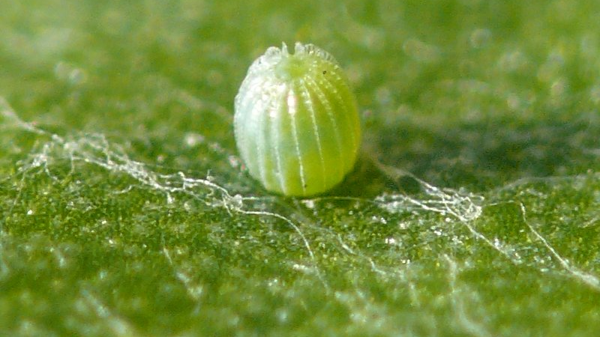
Painted lady butterfly egg
Notes:
https://commons.wikimedia.org/wiki/File:Vanessa_cardui_-_egg_02_(HS).jpg
Harald Süpfle, CC BY-SA 3.0 <https://creativecommons.org/licenses/by-sa/3.0>, via Wikimedia Commons

Slide 2
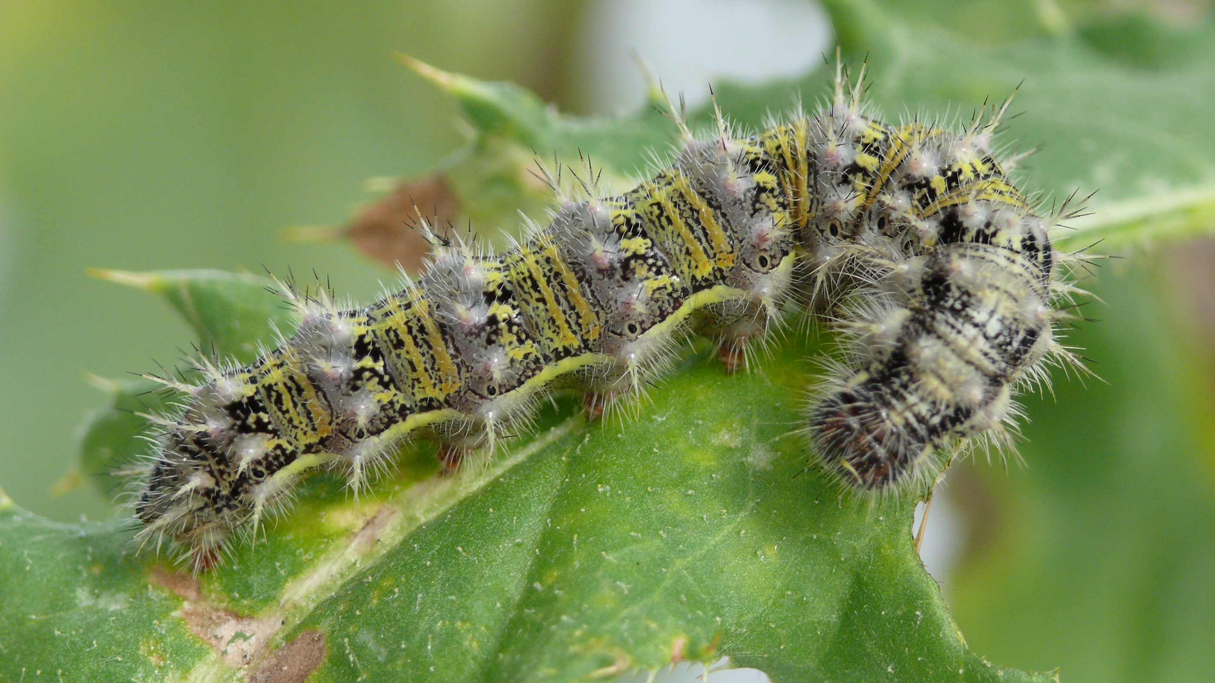
Painted lady butterfly larva
Notes:
https://commons.wikimedia.org/wiki/File:Vanessa_cardui_-_caterpillar_07_(HS).jpg
Harald Süpfle, CC BY-SA 3.0 <https://creativecommons.org/licenses/by-sa/3.0>, via Wikimedia Commons

