Slide 1
Memory Pictures
© 2024 Baylor College of Medicine.
Notes:
Note(s)
This slide is left purposely blank so that students will not see the first slide containing images until you are ready to project it. See the Day lesson for full instructions.

Slide 2
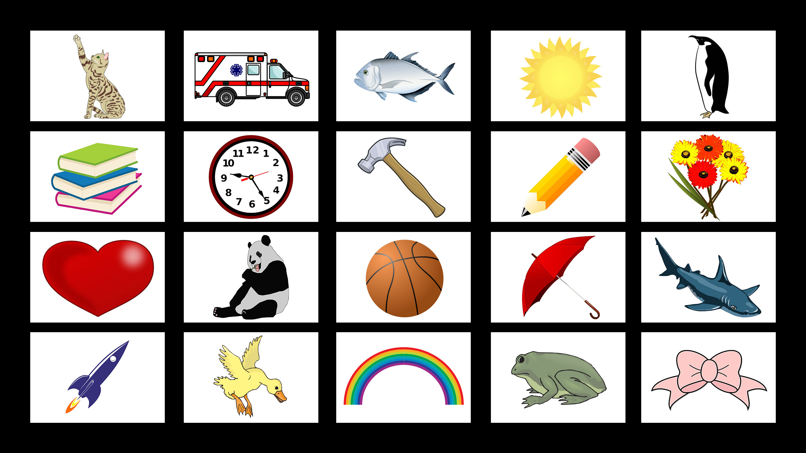
Notes:
Memory Pictures: Set 1
Illustrations courtesy of Openclipart.com: Cat, sun, penguin, books, clock, pencil, flowers, heart, panda bear/bear, umbrella shark, rocket, duck, rainbow, frog, bow. https://openclipart.org/
Illustrations licensed for use: Ambulance © Oleksandr Bolotov. Basketball © Petr Novotny. Fish © Blueringmedia. Hammer © Dian Permana.

Slide 3
Notes:
Note(s)
This slide is left purposely blank so that students will not see the first slide containing images until you are ready to project it. See Day 1, “Procedure,” for full instructions.
K-3 STEM Foundations. Day 1. Memory Pictures © Baylor College of Medicine.

Slide 4
Notes:
Memory Pictures: Set 2
Illustrations courtesy of Openclipart.com: Beach ball, bed, blocks, birdl, chair, dog, elephant, jack o’ lantern, teddy bear, rabbit, toy train, tree, turtle. https://openclipart.org/
Illustrations licensed for use: Airplane © Andrey Kokidko. Butterfly © Irina Artamonova. Flowers/roses © Nadejda Tchijova. Leaf © Almoond. Pig © Macrovector. School Bus © Denis Dubrovin. Soccer Ball © Petr Novotny. Almoond. Pig © Macrovector. School Bus © Denis Dubrovin. Soccer Ball © Petr Novotny.

Slide 5
Notes:
Note(s)
This slide is left purposely blank so that students will not see the first slide containing images until you are ready to project it. See Day 1, “Procedure,” for full instructions.

Slide 6
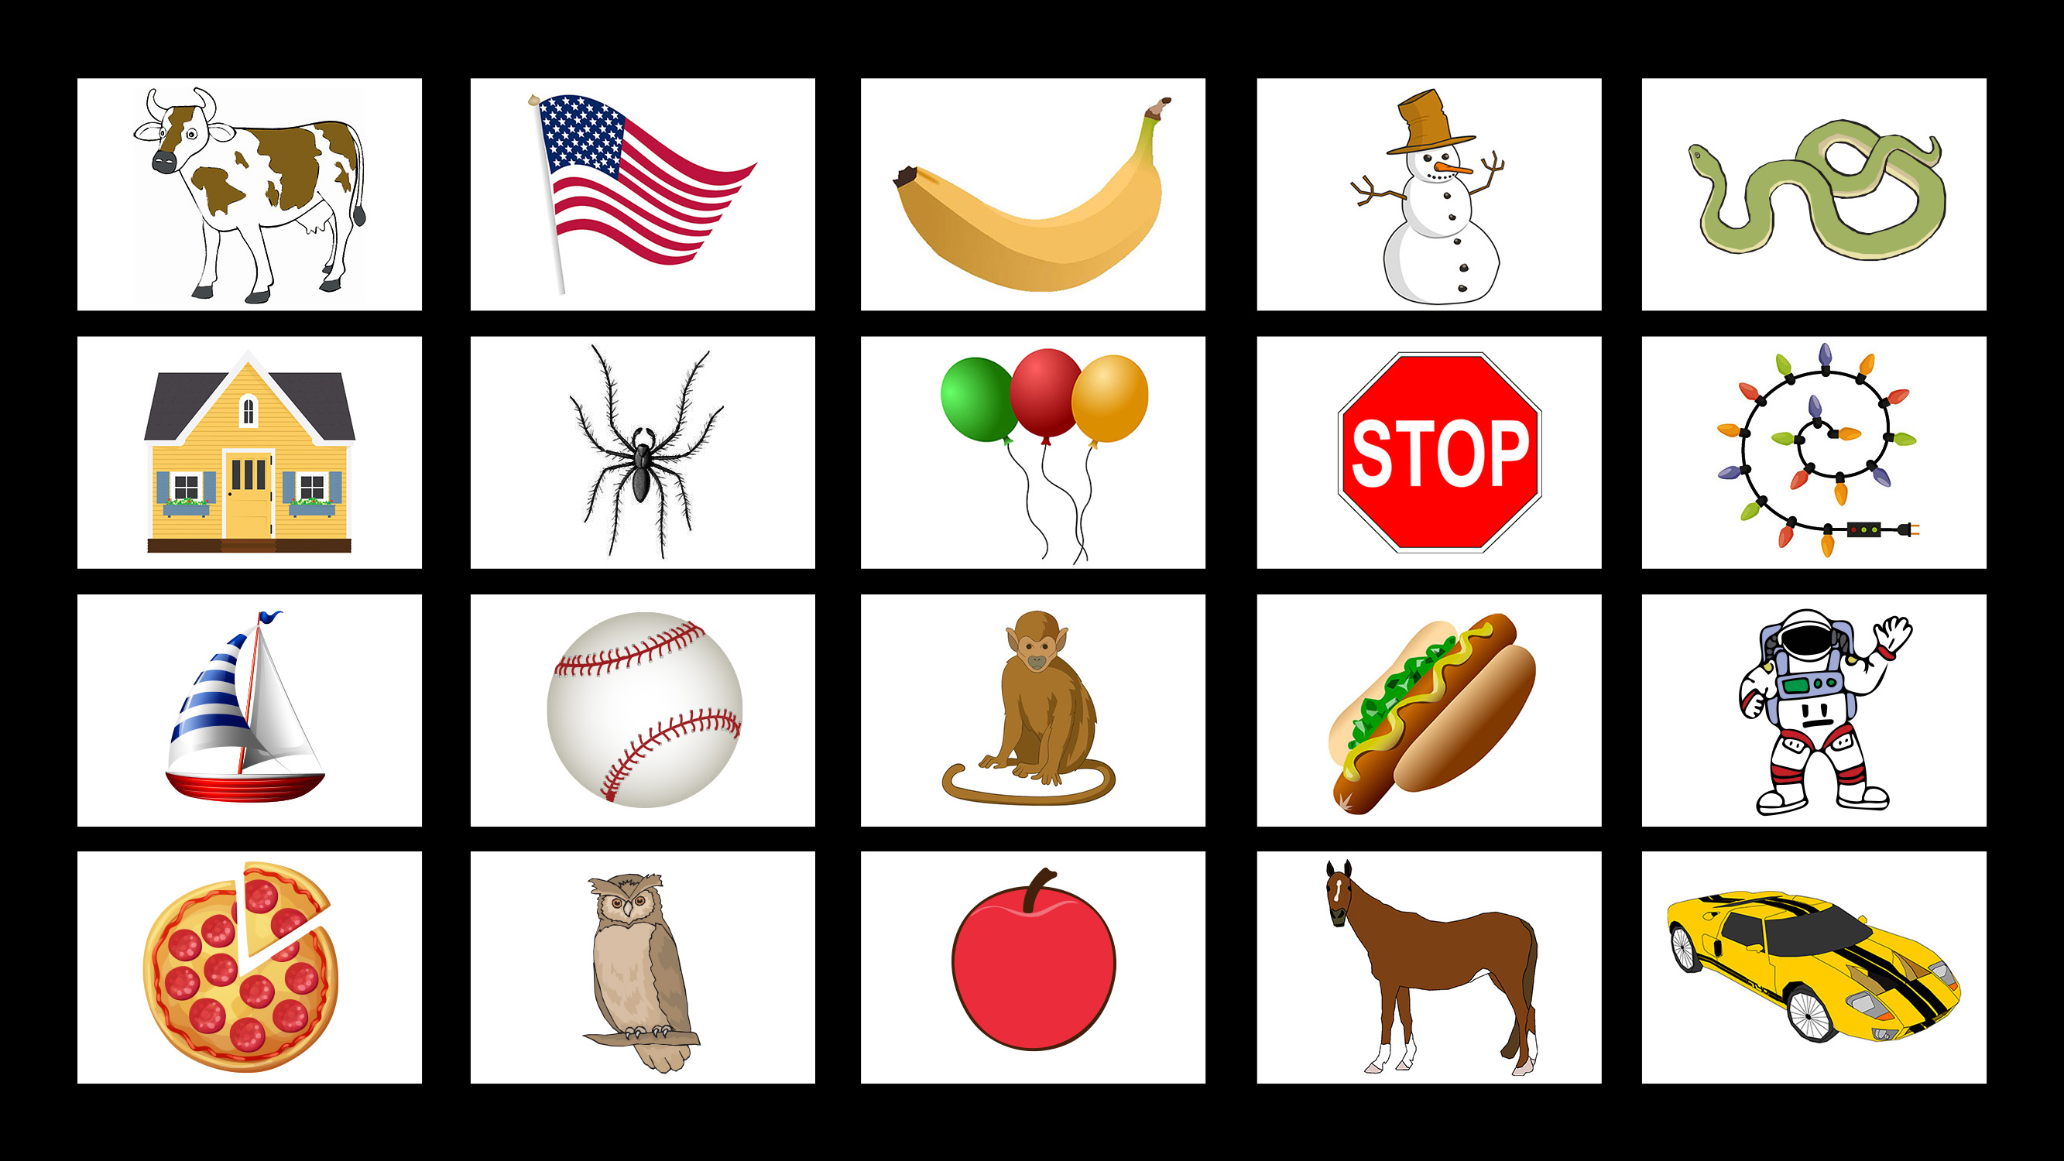
Notes:
Memory Pictures: Set: 3
Illustrations courtesy of Openclipart.com: Apple, astronaut, balloons, banana, baseball, Christmas lights, cow, flag, horse, hot dog, owl, snake, snowman, spider, sports car, stop sign. https://openclipart.org/
Illustrations licensed for use: House © Ksenia Varopaeva. Monkey © Ivan Ryabokon. Pizza © Anna Zasorina. Sailboat © Blueringmedia.

Slide 7
Notes:
Note(s)
This slide is left purposely blank so that students will not see the first slide containing images until you are ready to project it. See Day 1, “Procedure,” for full instructions.

