Slide 1
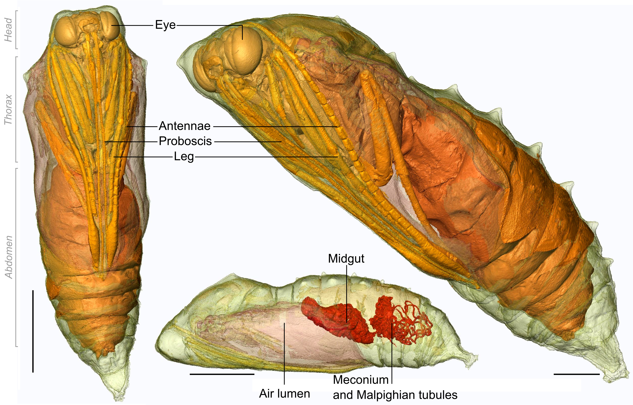
Notes:
https://commons.wikimedia.org/wiki/File:Painted_Lady_Chrysalis_micro_CT.jpg
Lowe, Tristan, University of ManchesterGarwood, Russell J., University of ManchesterSimonsen, Thomas J., Natural History MuseumBradley, Robert S., University of ManchesterWithers, Philip J., University of Manchester, CC0, via Wikimedia Commons

