Slide 1
Science Language Cards
for
Grade 2: Animal Life Cycles
© 2024 Baylor College of Medicine.

Slide 2
scientist
A scientist is a person who is an expert in or who studies aspects of the natural or physical world.
Notes:
Stock Images

Slide 3
organism
Organisms are living things that are able to carry out the actions needed to live, grow, and survive.
Notes:
Stock Images

Slide 4
larva/larvae
A larva is the wingless, often wormlike form in the life cycle of a newly hatched insect (larva is singular, larvae is plural).
"Danaus plexippus, Monarch Butterfly Larvae" by David Illig is licensed under CC BY-NC-SA 2.0.

Slide 5
caterpillar
A caterpillar is the larval stage in the life cycle of a butterfly.
"12 Days of Christmas Butterflies: #12 Monarch caterpillar" by Vicki's Nature is licensed under CC BY-NC-ND 2.0.

Slide 6
butterfly
When a caterpillar is transformed into a butterfly, it has reached the adult stage in its life cycle.
"butterfly" by davidyuweb is licensed under CC BY-NC 2.0.

Slide 7
habitat
A habitat is the place where an organism usually lives and grows.
"Forest" by targut is licensed under CC BY 2.0.

Slide 8
data
Data are facts and information (such as images, words, and measurements) collected during an investigation.
Notes:
Stock Images

Slide 9
measure
We use rulers, yardsticks, scales, and other tools to measure the size, weight, or amount of something.
Notes:
Stock Images

Slide 10
instar
The stages between an insect larva’s molts are called instars.
"Antheraea pernyi 1st instar 1 sjh" by No machine-readable author provided. Kugamazog~commonswiki assumed (based on copyright claims). is licensed under CC BY-SA 2.5.

Slide 11
molting
During the molting process, a caterpillar sheds and replaces skin as it grows.
"Cicada molting" by Anita363 is licensed under CC BY-NC 2.0.

Slide 12
tracking
The process of following something or someone is called tracking.
"Snow Tracks" by Chalkie_CC is licensed under CC BY-NC 2.0.

Slide 13
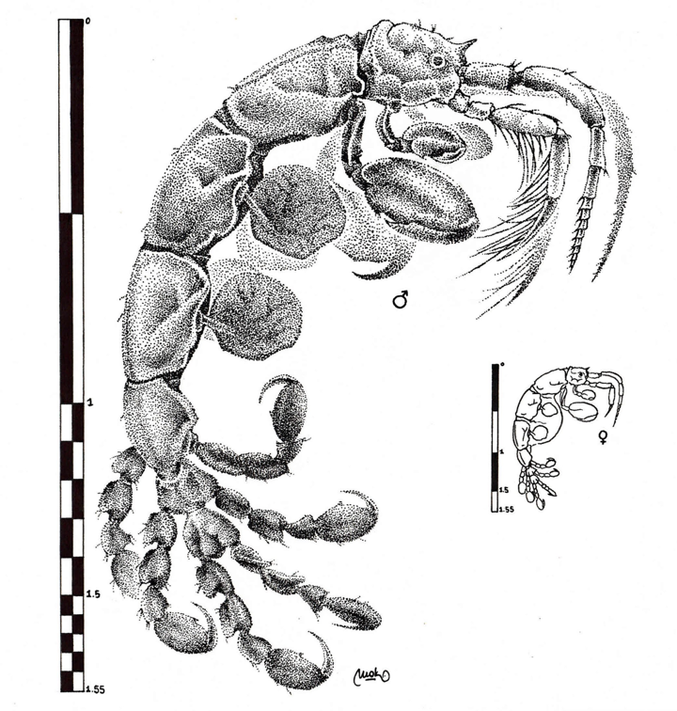
scientific Illustration
A scientific illustration is picture or diagram that explains or helps make something clear, such as the anatomy of a shrimp.
"Caprella andreae" by Martin Mak is licensed under CC BY 3.0

Slide 14
scientific description
Scientific description uses details or evidence based on observation to help visualize or explain a subject being described.
"Scientific Drawings" by BLM Alaska is marked with Public Domain Mark 1.0.

Slide 15
collaboration
Collaboration occurs when two or more people work together, learn from each other, and communicate with each other.
"Collaboration" by quinn.anya is licensed under CC BY-SA 2.0.

Slide 16
migration
Migration is the seasonal movement of animals from one region to another.
"Sandhill Migration on the Platte River" by USFWS Mountain Prairie is licensed under CC BY 2.0. To view a copy of this license, visit https://creativecommons.org/licenses/by/2.0/?ref=openverse.

Slide 17
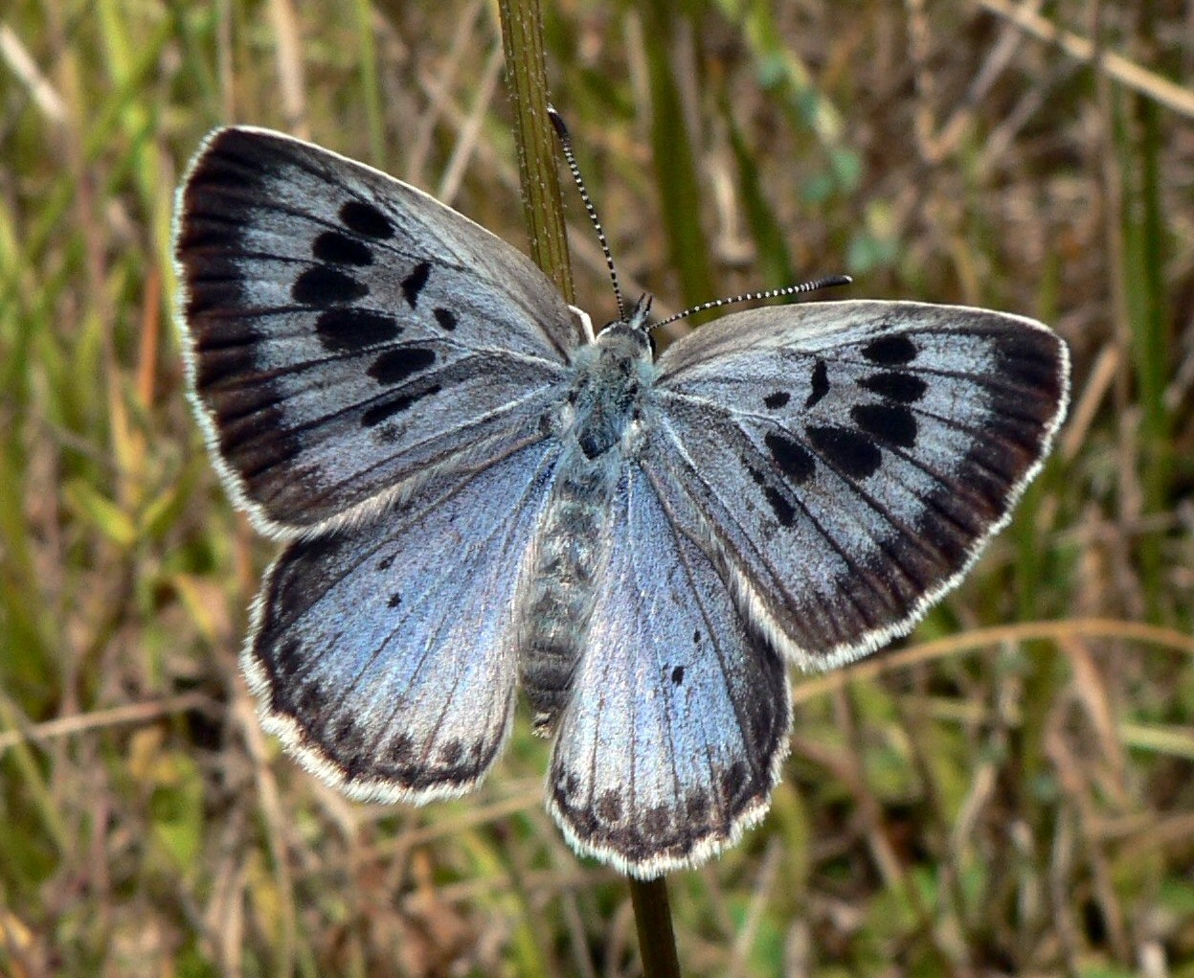
gliding
When a butterfly is gliding, it flies smoothly without flapping its wings.
"More details Large Blue butterfly, Maculinea arion, Rabastens-de-Bigorre, Hautes Pyrénées, France" by PJC&Co is licensed under CC BY 3.0

Slide 18
team
A team, or teamwork, is a group of people who work together to accomplish a goal or task.
"Student teams to compete in eCYBERMISSION science competition finals." by U.S. Army Combat Capabilities Development Command is licensed under CC BY 2.0.

Slide 19
analyze
Analyze means to carefully examine details or specific information.
This Photo by Unknown author is licensed under CC BY-SA-NC.

Slide 20
chrysalis
A chrysalis is the hard outer covering that protects a pupa.
"Be-Jeweled Monarch (Butterfly) Chrysalis" by goingslo is licensed under CC BY 2.0.

Slide 21
pupa/pupae
An insect pupa is in the stage of development between a larva and a fully grown adult (pupa is singular, pupae is plural).
"Painted Lady (Vanessa cardui) butterfly pupa" by Deanster1983 who's on and off is licensed under CC BY-ND 2.0. To view a copy of this license, visit https://creativecommons.org/licenses/by-nd/2.0/?ref=openverse.

Slide 22
spinneret
A spinneret is the tubelike structure on a caterpillar’s mouth that produces liquid silk.
"Painted Lady caterpillar - Vanessa cardui on Bristly Fiddleneck - Amsinckia tessellata, Joshua Tree National Park, Twentynine Palms, California" by Judy Gallagher is licensed under CC BY 2.0. To view a copy of this license, visit https://creativecommons.org/licenses/by/2.0/?ref=openverse.

Slide 23
life cycle
A life cycle describes the stages or changes an organism goes through during its life.
Adobe Stock Image #94927008

Slide 24
metamorphosis
When animals or insects go through a dramatic change in a life cycle, it is called metamorphosis.
"Metamorphosis: Free as a Butterfly and Ready to Fly" by chekabuje is licensed under CC BY-NC 2.0.

