Slide 1
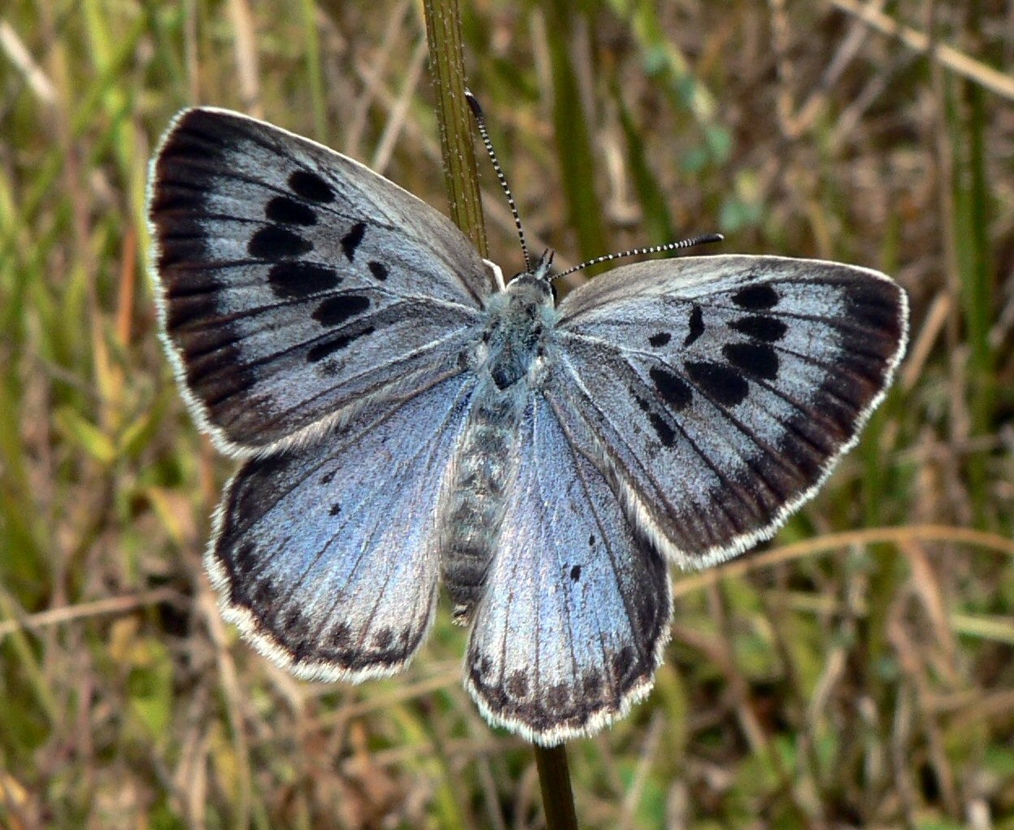
When a butterfly is gliding, it flies smoothly without flapping its wings.
Notes:
"More details Large Blue butterfly, Maculinea arion, Rabastens-de-Bigorre, Hautes Pyrénées, France" by PJC&Co is licensed under CC BY 3.0

