Slide 1
This Photo by Unknown Author is licensed under CC BY-SA
Notes:
Traits are physical attributes you can see such as the shape of leaves. We can identify different species of plants by the traits they share.

Slide 2
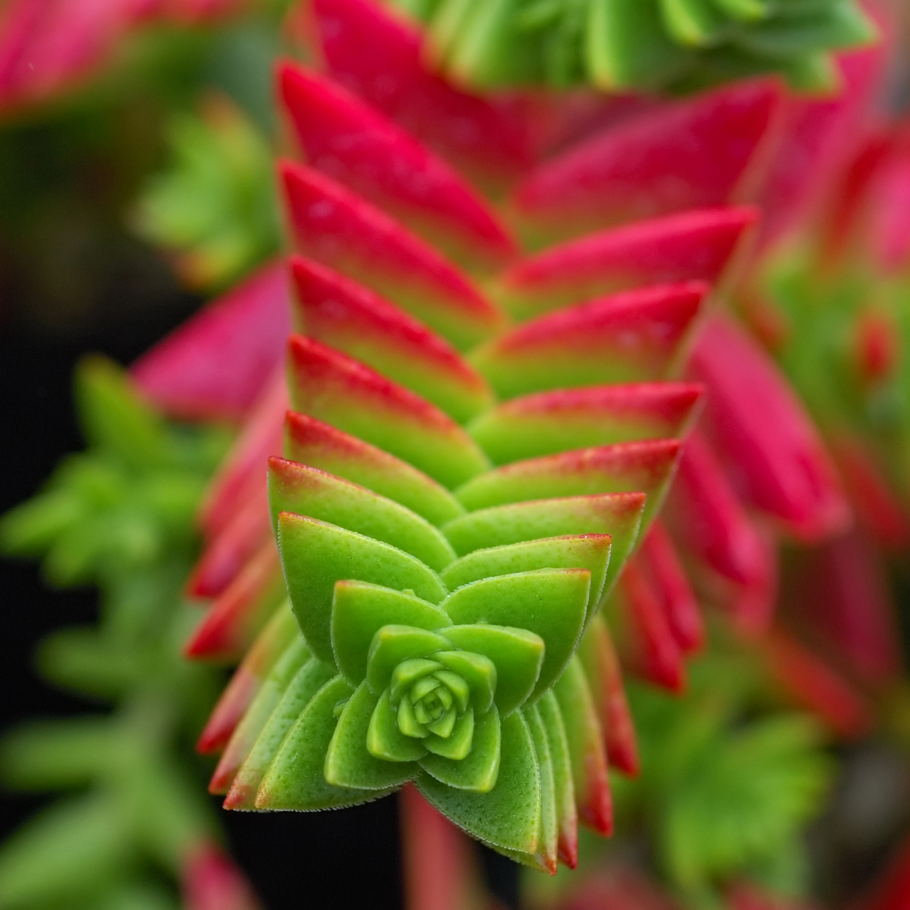
What traits are the same in these plants? How are they different?
https://commons.wikimedia.org/wiki/File:Rosa_de_alabastro_(Echeveria_elegans),_jard%C3%ADn_del_molino,_Sierra_de_San_Felipe,_Set%C3%BAbal,_Portugal,_2012-05-11,_DD_01.JPG
Diego Delso, CC BY-SA 3.0 <https://creativecommons.org/licenses/by-sa/3.0>, via Wikimedia Commons
https://commons.wikimedia.org/wiki/File:Crassula_capitella_2_edit.jpg
Eric Hunt (Photograph edited by Vassil), CC BY-SA 2.5 <https://creativecommons.org/licenses/by-sa/2.5>, via Wikimedia Commons

