Slide 1
Plant Images for Inquiry Circles (Day 1)

Slide 2
MOSS
URL: https://commons.wikimedia.org/wiki/File:MossOnConcreteWall.jpgceae
Attribution: Wvangeit, CC BY-SA 4.0 <https://creativecommons.org/licenses/by-sa/4.0>, via Wikimedia Commons

Slide 3
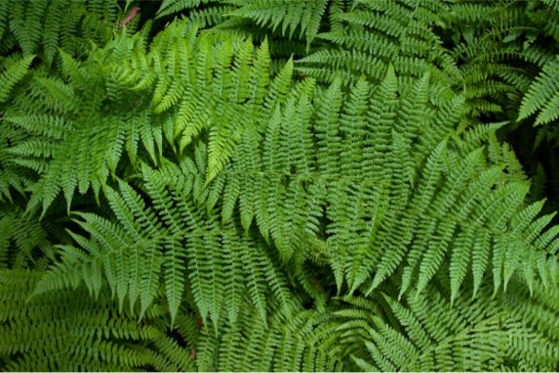
FERNS
URL: https://commons.wikimedia.org/wiki/File:Sa-fern.jpg​
Attribution: Sanjay ach, CC BY-SA 3.0 &lt;http://creativecommons.org/licenses/by-sa/3.0/&gt;, via Wikimedia Commons

Slide 4
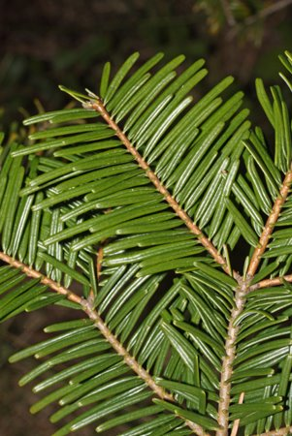
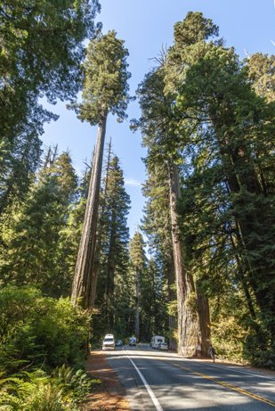
CONIFERS
URL: https://commons.wikimedia.org/wiki/File:US_199_Redwood_Highway.jpg​
Attribution: Acroterion, CC BY-SA 3.0 <https://creativecommons.org/licenses/by-sa/3.0>, via Wikimedia Commons
URL: https://commons.wikimedia.org/wiki/File:Abies_grandis_5359.JPG​
Attribution: Walter Siegmund, CC BY-SA 3.0 <https://creativecommons.org/licenses/by-sa/3.0>, via Wikimedia Commons

Slide 5
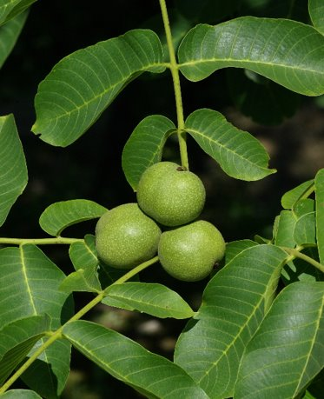
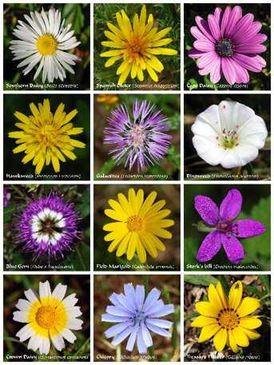
FLOWERING PLANTS
URL:https://commons.wikimedia.org/wiki/File:Noyer_feuilles%26fruits_%C3%A9t%C3%A9_FR_2012.jpg​
Attribution: JLPC, CC BY-SA 3.0 <https://creativecommons.org/licenses/by-sa/3.0>, via Wikimedia Commons
URL: https://commons.wikimedia.org/wiki/File:Flower_poster.jpg​
Attribution: Alvesgaspar, CC BY-SA 3.0 <https://creativecommons.org/licenses/by-sa/3.0>, via Wikimedia Commons

