Slide 1
Day 7 Plant Images
© 2023 Baylor College of Medicine. Field Test Version: Do not distribute, photocopy, or forward this document for use at other locations.

Slide 2
Lycopodium
This is a branch from a tree-sized lycopod, or club moss.
Living lycopods are small, but they once grew into huge, now-extinct trees.
During this fossil time period, the climate had warmed up again after the last ice age.
What clues tell us what type of fossil this plant became?
Notes:
https://commons.wikimedia.org/wiki/File:Lycopod_axis.jpg
Kennethgass, CC BY-SA 4.0 <https://creativecommons.org/licenses/by-sa/4.0>, via Wikimedia Commons

Slide 3
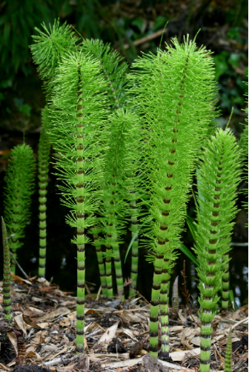
Horsetails (Equisetum telmateia)
Horsetails are a living fossil.
About 360 million years ago, horsetails were 30 meters (98 feet) tall!
Notes:
URL: https://commons.wikimedia.org/wiki/File:Equisetopsida.jpg
Attribution: Rror, CC BY-SA 3.0&lt;https://creativecommons.org/licenses/by-sa/3.0&gt;, via Wikimedia Commons

Slide 4
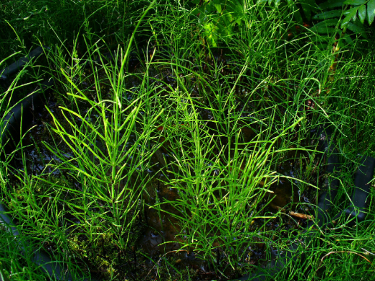
Field horsetails (Equisetum arvense)
Field horsetails are another of the many different types of horsetails.
Notes:
URL: https://commons.wikimedia.org/wiki/File:Equisetum_arvense_001.JPG
Attribution: H. Zell, CC BY-SA 3.0&lt;https://creativecommons.org/licenses/by-sa/3.0&gt;, via Wikimedia Commons

Slide 5
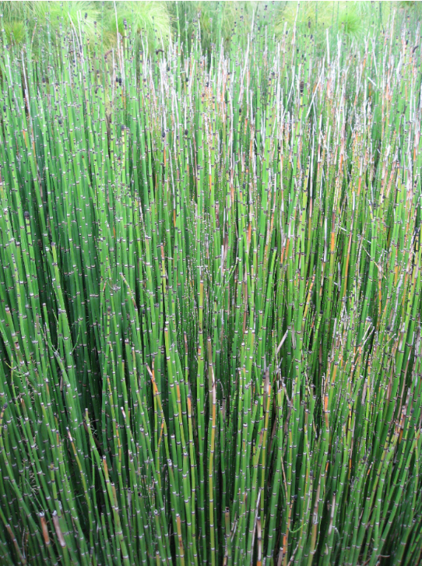
Horsetail Reeds
Horsetail reeds looks different from the other types of horsetails.
Notes:
URL: https://commons.wikimedia.org/wiki/File:Equisetum_hyemale_02_by_Line1.jpg
Attribution: Liné1, CC BY-SA 3.0 &lt;https://creativecommons.org/licenses/by-sa/3.0&gt;, via Wikimedia Commons

Slide 6
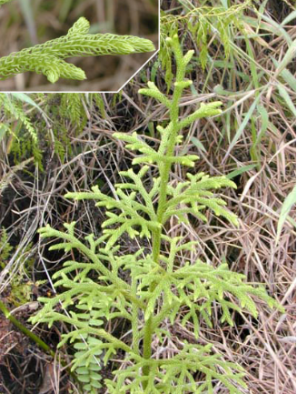
Club Mosses
Club mosses belong to a family of plants called lycopods.
Their fossils are found worldwide.
Like the horsetails and ferns, they grew very tall millions of years ago, but now they are smaller.
Notice the enlarged picture of a branch.
Notes:
URL: https://commons.wikimedia.org/wiki/File:Lycopodium_plant.jpg
Attribution: Eric Guinther, CC BY-SA 3.0 &lt;http://creativecommons.org/licenses/by-sa/3.0/&gt;, via Wikimedia Commons

Slide 7
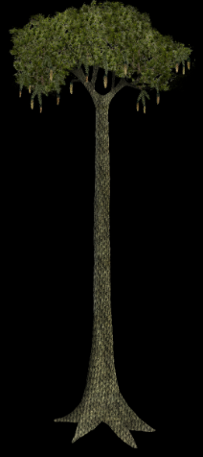
Lepidodendron
Fossil tree-like forms such as Lepidodendron “scale trees” formed huge forests millions of years ago.
Leaves grew out of the sides of the trunk and branches and left diamond shaped scars where the leaves fell off.
This is a drawing of what a Lepidodendrum might have looked like.
Notes:
URL: https://commons.wikimedia.org/wiki/File:Lepidodendron.png
Attributions: Tim Bertelink, CC BY-SA 4.0 &lt;https://creativecommons.org/licenses/by-sa/4.0&gt;, via Wikimedia Commons

Slide 8
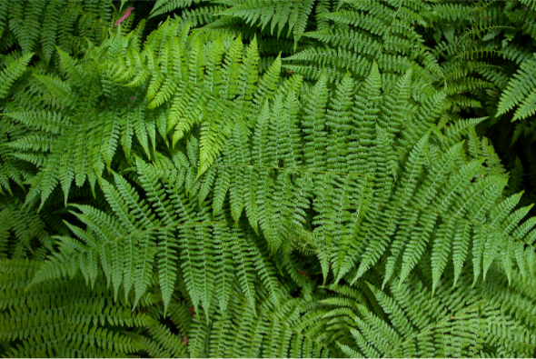
Ferns
Ferns do not have seeds or flowers.
Their leaves are sometimes called fronds. The leaves have a central stalk and many small leaflets.
Notes:
URL: https://commons.wikimedia.org/wiki/File:Sa-fern.jpg
Attribution: Sanjay ach, CC BY-SA 3.0 &lt;http://creativecommons.org/licenses/by-sa/3.0/&gt;, via Wikimedia Commons

Slide 9
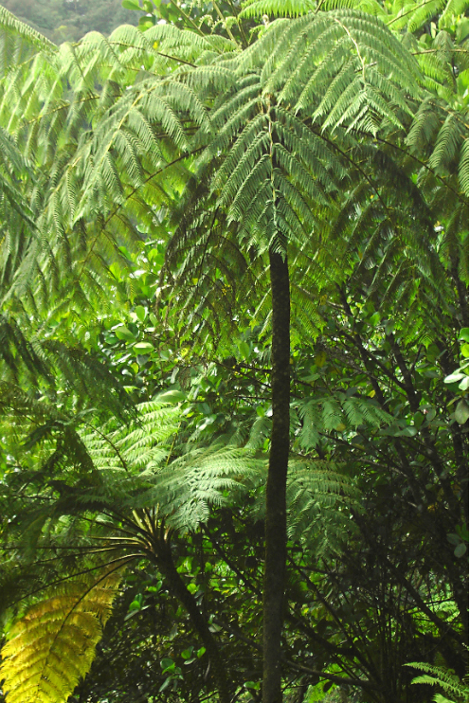
Tree Ferns
Giant ferns appeared millions of years ago.
Tree ferns can still be found in rainforests.
Notes:
URL: https://commons.wikimedia.org/wiki/File:Rainforest_near_Belle_-_Dominica.jpg
Attribution: © Hans Hillewaert

