Slide 1
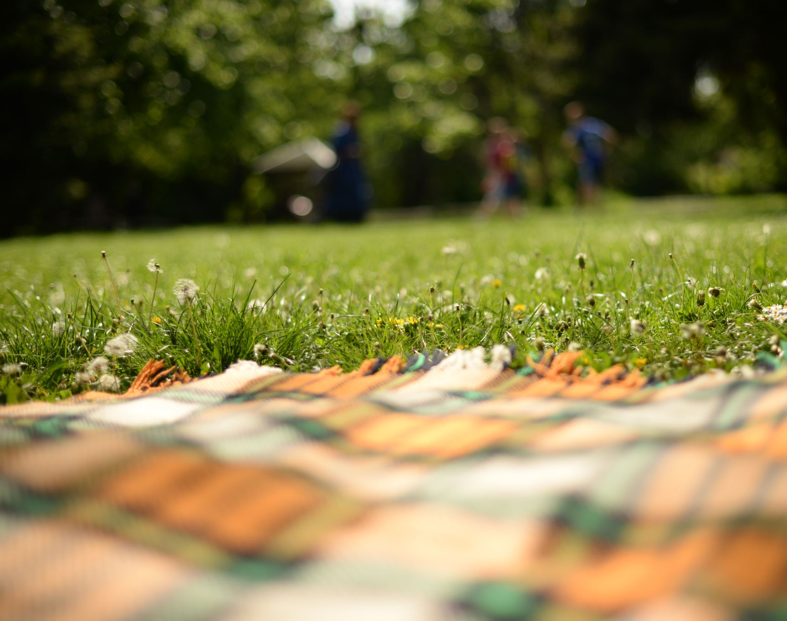
Outdoor Organisms

Slide 2
snail

Slide 3
earthworms

Slide 4
termites

Slide 5
ant
This Photo by Unknown Author is licensed under CC BY-SA-NC

Slide 6
slug

Slide 7
beetle

Slide 8
millipede

