Slide 1
Science Language Picture Cards
G1

Slide 2
Bacteria
Bacteria are organisms so small they can only be seen through a microscope. Some are decomposers that break down dead organisms.

Slide 3
Claim
A claim is a statement of what you think is true based on observation and evidence.
"2010-07-11 - Summer Camp 2010 - Kids talking notes in the woods" by Leslie Science & Nature Center is licensed under CC BY-SA 2.0.

Slide 4
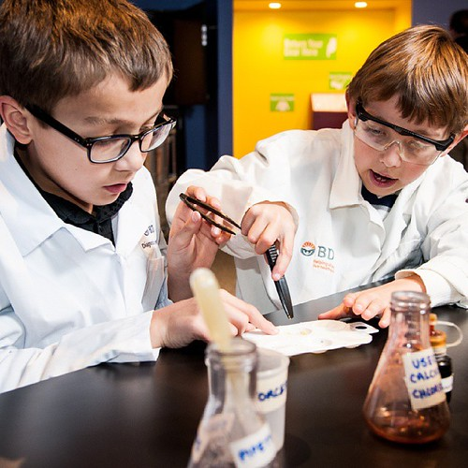
Collaboration
Collaboration happens when two or more people work, learn, and talk with each other.
This Photo by Unknown Author is licensed under CC BY-ND

Slide 5
Consumers
Consumers cannot make their own food. They get their energy from eating producers and other consumers.
"Wild Black Bear at Anan Bear Observatory" by AER Wilmington DE is licensed under CC BY 2.0

Slide 6
Data
Data are facts and information (such as images, words, and measurements) collected during an investigation.

Slide 7
Decay
Decay is the process of rotting or decomposition that breaks down material when an organism dies.

Slide 8
Decomposers
Decomposers eat or break apart dead plants and animals, recycling nutrients that plants need
for growing.
"Earthworm" by pfly is licensed under CC BY-SA 2.0.

Slide 9
Ecosystem
An ecosystem is a community of organisms that live and interact with each other and their nonliving environment.
This Photo by Unknown Author is licensed under CC BY-SA-NC
"

Slide 10
Energy
Living things get energy from the food they eat
to help them
move, grow,
and survive.
https://pxhere.com/en/photos?q+goats+eating&search=animals+eating

Slide 11
Environment
An environment
is the natural place
or surroundings
where organisms live.
https://pxhere.com/en/photo/670793

Slide 12
Evidence
Evidence is data collected from an investigation that supports (backs up) explanations and answers.

Slide 13
Food Chain
A food chain
describes the sequence of
who eats whom
that transfers energy between organisms.
This Photo by Unknown Author is licensed under CC BY-NC
"food chain open" by jimmiehomeschoolmom is licensed under CC BY 2.0.

Slide 14
Fungi
Fungi are a group of decomposers that feed on decaying matter. Mushrooms are a type of fungi.
"Mushrooms" by Tweek is licensed under CC BY-SA 2.0.

Slide 15
Habitat
A habitat is a place where organisms live and grow.
"McDonald Forest - Corvallis, Oregon" by Dougtone is licensed under CC BY-SA 2.0.

Slide 16
Hypothesis
A hypothesis is an idea that can be tested or investigated to see if it is true.
This Photo by Unknown author is licensed under CC BY-SA-NC.
"Day 53 - West Midlands Police Forensic Scene Investigators Lab" by West Midlands Police is licensed under CC BY-SA 2.0.

Slide 17
Interdependence
Interdependence means depending on and needing each other
for survival.
"Bee on Yellow Flower" by gdbwb05 is licensed under CC BY-ND 2.0

Slide 18
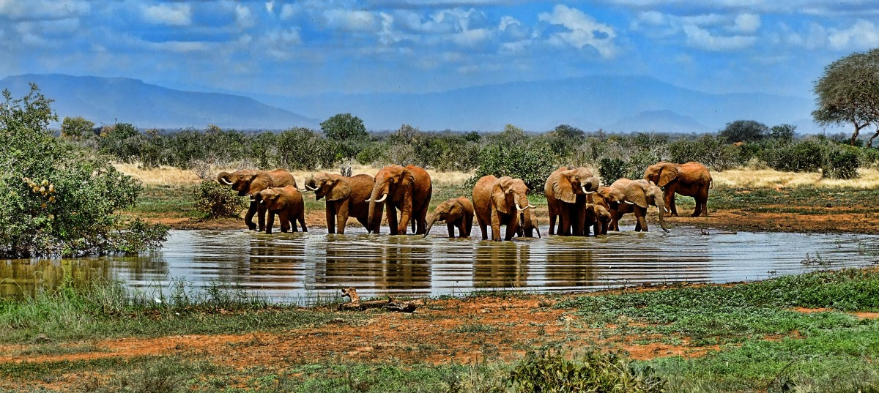
Needs
Organisms have needs for surviving such as water, energy, air, and
a place to live.

Slide 19
Nutrients
Nutrients are nourishments and substances found in food that help organisms survive and grow.
"Cute Irish squirrel eating grass II" by Tambako the Jaguar is licensed under CC BY-ND 2.0.

Slide 20
Observation
Observation is carefully looking
at something or someone to gather information.
"CERDEC Math and Science Summer Camp, 2013" by CCDC_C5ISR is licensed under CC BY 2.0.

Slide 21
Organisms
Organisms are living things that carry out the activities needed
to live, grow,
and survive.
"snail - Cullompton Leat Fields, Devon - 18 May 2018" by Dis da fi we is licensed under CC BY-NC-SA 2.0.

Slide 22
Prediction
A prediction is our best guess about what we think might happen.
"Playing Guess My Number" by Kathy Cassidy is licensed under CC BY-NC-SA 2.0.t

Slide 23
Producers
Producers make their own food from simple substances and energy from the Sun. Plants are producers.
“Apple Tree” by amiefedora is licensed under CC BY-ND 2.0.

Slide 24
Reasoning
Reasoning means thinking about and explaining how the evidence supports a claim.
"Thinking" by Miroslav Vajdić is licensed under CC BY-SA 2.0.

Slide 25
Research
Research is a careful search for facts
or information.
This Photo by Unknown Author is licensed under CC BY-SA

Slide 26
Scientific Inquiry
Scientific inquiry is using evidence from texts, observations, and investigations to find answers to questions.

Slide 27
Scientific Investigation
A scientific investigation is a plan for finding answers to questions and solving problems.
"Science Careers in Search of Women 2009" by Argonne National Laboratory is licensed under CC BY-NC-SA 2.0.

Slide 28
Scientist
A scientist is a person who is an expert in or who studies aspects of the natural or physical world.
"Scientist observing cowpea leaf under microscope in the laboratory" by IITA Image Library is licensed under CC BY-NC 2.0.

Slide 29
Team
A team, or teamwork, is a group of people who work together to accomplish a goal or task.
This Photo by Unknown Author is licensed under CC BY-NC-ND

Slide 30
Testable Question
A testable question
can be answered
by conducting an investigation or experiment.
What do Roly-polies eat?

