Slide 1
Day 15
Family Traits
Notes:
K-3 STEM Foundations
Field Test Version: Do not distribute, photocopy or forward this document for use at other locations.
Day 15: Inherited Butterfly Wing Characteristics
Teacher Notes
Keywords
lesson, animal, gene, inherited, trait, characteristics,
K-3 STEM Foundations. Day 15: Family Traits © Baylor College of Medicine.

Slide 2
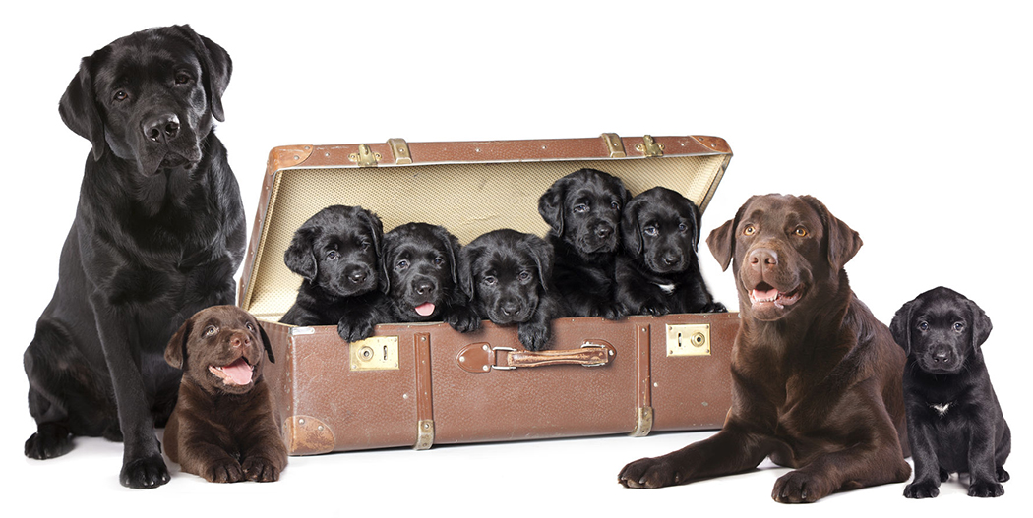
A Family of Dogs
In science, the word “offspring” often is used in place of the word “children.”
Do you see similarities between these parents and their offspring?
Father
Mother
Notes:
K-3 STEM Foundations
Field Test Version: Do not distribute, photocopy or forward this document for use at other locations.
Day 15: Inherited Butterfly Wing Characteristics
Teacher Notes
Image Reference
Photo of dogs © Liliya Kulianionak. Licensed for use.
Keywords
lesson, animal, family, offspring, parent, characteristic, trait
K-3 STEM Foundations. Day 15: Family Traits © Baylor College of Medicine.

Slide 3
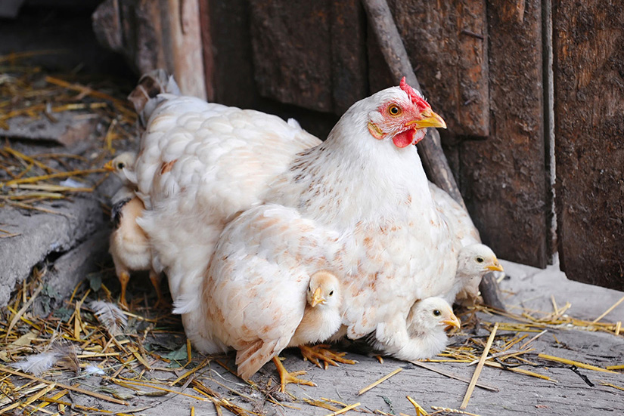
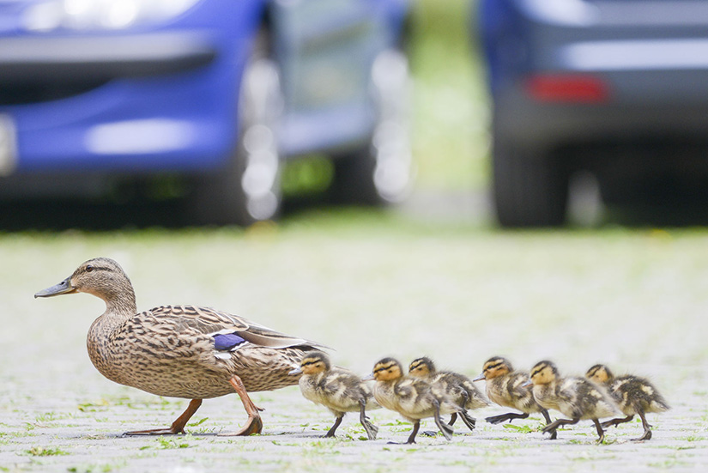
What Is a Trait?
Animal families usually have characteristics they all share.
Characteristics also are called traits.
Notes:
K-3 STEM Foundations
Field Test Version: Do not distribute, photocopy or forward this document for use at other locations.
Day 15: Inherited Butterfly Wing Characteristics
Teacher Notes
Image References
Photo of chickens © Nataliia Melnychuk. Licensed for use.
Photo of ducks © Piotr Kamionka. Licensed for use.
Keywords
lesson, animal, family, offspring, parent, characteristic, trait, inherited trait,
K-3 STEM Foundations. Day 15: Family Traits © Baylor College of Medicine.

Slide 4
What Is a Trait?
Inherited Traits
Turn and Talk
Examples of traits might include color of feathers, eye color, beak shape, and type of feet.
What are other traits you can think of?
White feathers
Brown feathers
Notes:
K-3 STEM Foundations
Field Test Version: Do not distribute, photocopy or forward this document for use at other locations.
Day 15: Inherited Butterfly Wing Characteristics
Teacher Notes
Image References
Photo of chickens © Nataliia Melnychuk. Licensed for use.
Photo of ducks © Piotr Kamionka. Licensed for use.
Keywords
lesson, animal, family, offspring, parent, characteristic, trait, inherited trait,
K-3 STEM Foundations. Day 15: Family Traits © Baylor College of Medicine.

Slide 5
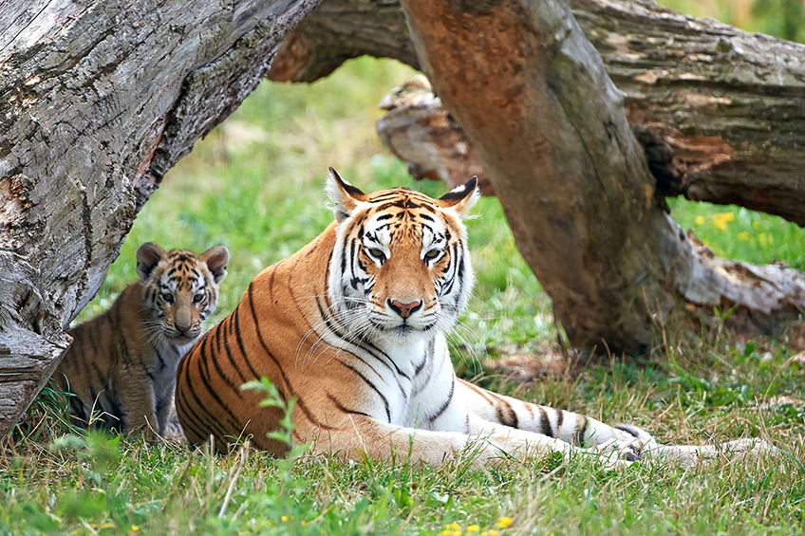
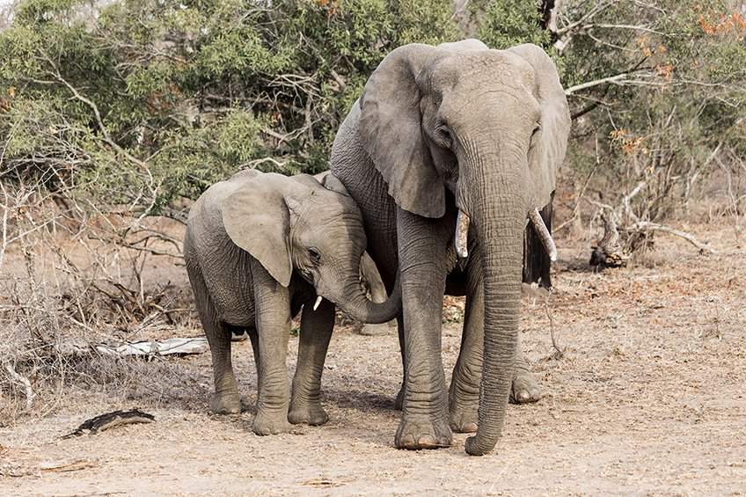
Inherited Traits
Traits are inherited from parents to their offspring.
This just means traits are passed from parent to child.
Stripes are inherited.
Ear shapes are inherited.
Notes:
K-3 STEM Foundations
Field Test Version: Do not distribute, photocopy or forward this document for use at other locations.
Day 15: Inherited Butterfly Wing Characteristics
Teacher Notes
Image Reference
Photo of tigers © Dennis Jacobsen. Licensed for use.
Photo of elephants © Andreas Bucher. Licensed for use.
Keywords
lesson, animal, gene, inherited, trait, characteristics,
K-3 STEM Foundations. Day 15: Family Traits © Baylor College of Medicine.

Slide 6
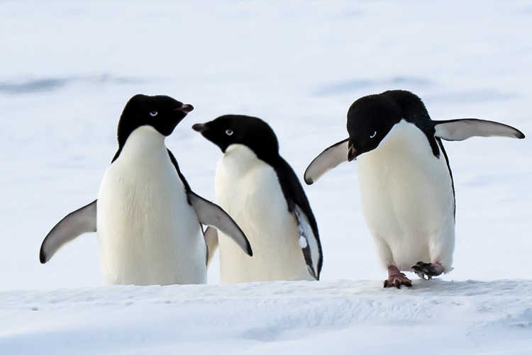
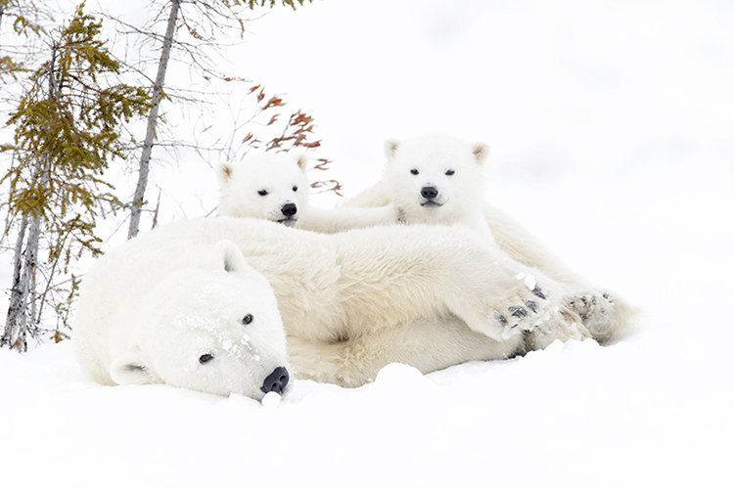
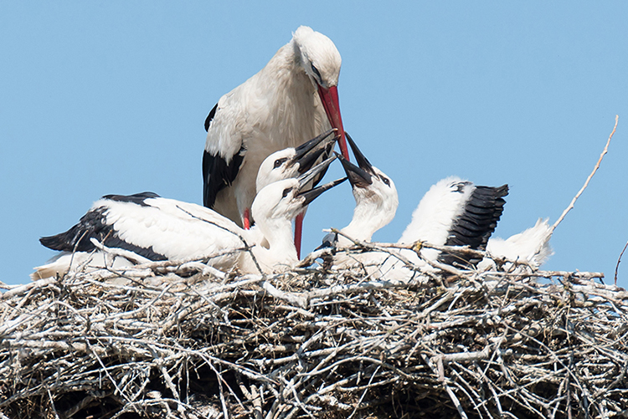
Turn and Talk
What other animals have inherited traits? Give examples.
Penguins
Polar Bears
Storks
Notes:
K-3 STEM Foundations
Field Test Version: Do not distribute, photocopy or forward this document for use at other locations.
Day 15: Inherited Butterfly Wing Characteristics
Teacher Notes
Image References
Photo of penguins courtesy of the U.S. Antarctic Program, USAP Photo Library, National Science Foundation. Taken January 6, 2017 by Tien Lai. https://photolibrary.usap.gov/#27-3
Photo of storks © Piotr Kamionka. Licensed for use.
Photo of polar bears © Andreanita. Licensed for use.
Keywords
lesson, animal, gene, trait, characteristics,
K-3 STEM Foundations. Day 15: Family Traits © Baylor College of Medicine.

Slide 7
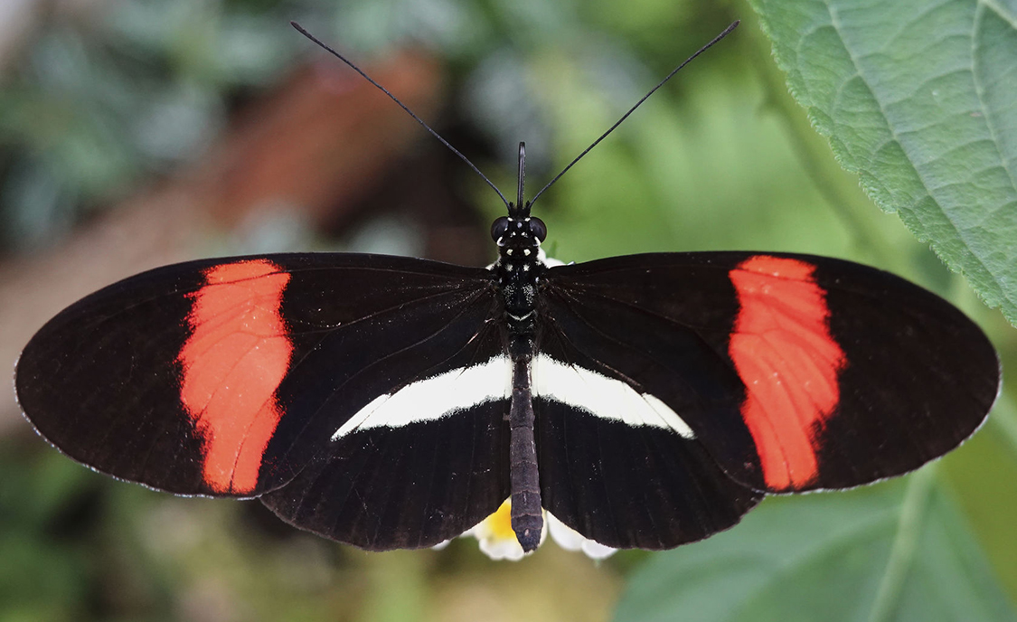
Large Families Can Have Different Traits
This is a Heliconius butterfly, like the butterflies we examined yesterday.
Notes:
K-3 STEM Foundations
Field Test Version: Do not distribute, photocopy or forward this document for use at other locations.
Day 15: Inherited Butterfly Wing Characteristics
Teacher Notes
Image Reference
Photo of Heliconius butterfly © Dennis Jacobsen. Licensed for use.
Keywords
lesson, animal, gene, inherited, trait, characteristics,
K-3 STEM Foundations. Day 15: Family Traits © Baylor College of Medicine.

Slide 8
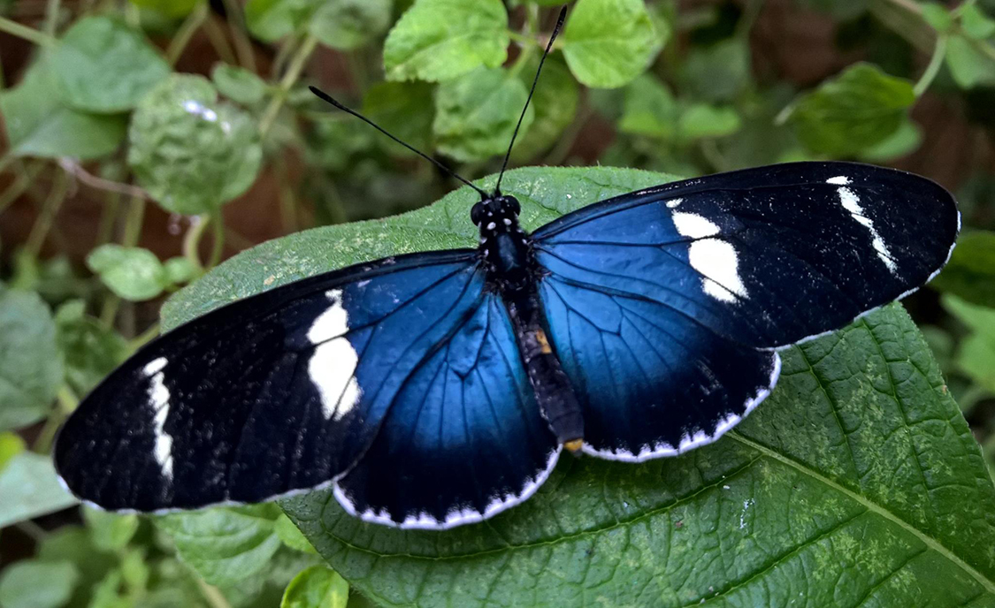
Turn and Talk
This also is a Heliconius butterfly.
It looks different than the one we looked at.
What do you think this butterfly’s parents looked like? Why?
Notes:
K-3 STEM Foundations
Field Test Version: Do not distribute, photocopy or forward this document for use at other locations.
Day 15: Inherited Butterfly Wing Characteristics
Teacher Notes
Image Reference
Photo of Heliconius butterfly © Nancy Miorelli. Used with permission. https://askentomologists.com/2016/05/30/fleeting-moments-how-long-do-butterflies-live/
Keywords
lesson, animal, gene, inherited, trait, characteristics,
K-3 STEM Foundations. Day 15: Family Traits © Baylor College of Medicine.

